Slide 1
Strategies for Overcoming the Calculus Barrier: An Intersegmental Approach
Frank Bäuerle, Hongde Hu and Larry Green

Slide 2
Topics
What is the Grand Challenge?
Description of the Four Projects
Student Centered Approach
Database and Finding Materials
How to Use The Projects in Your Calculus Class

Slide 3
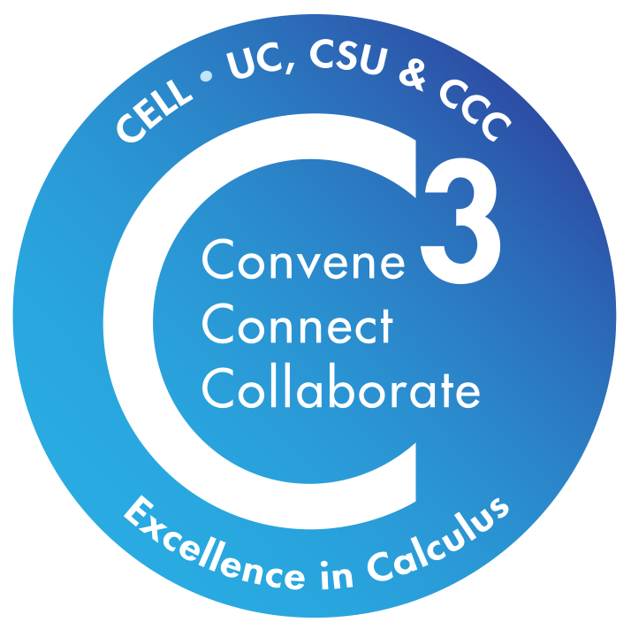
C3: Convene, Connect and Collaborate (Lake Tahoe CC, UCOP, UCLA, UCSC, CSU Monterey Bay )
The C3 team is building a teaching and learning community to boost the success of women and underrepresented students in STEM, focusing on calculus. Their goal is to reimagine the role of calculus in the first-year STEM experience and innovate its teaching methods.

Slide 4
C3 Activities
Meet most Fridays
Organize an annual conference
Regularly check in with the calculus teams
Share information:
Conference Opportunities
OER definitions and sharing
Model Framework
Help develop a prototype of a curated and searchable database of Grand Challenge Calculus assets

Slide 5
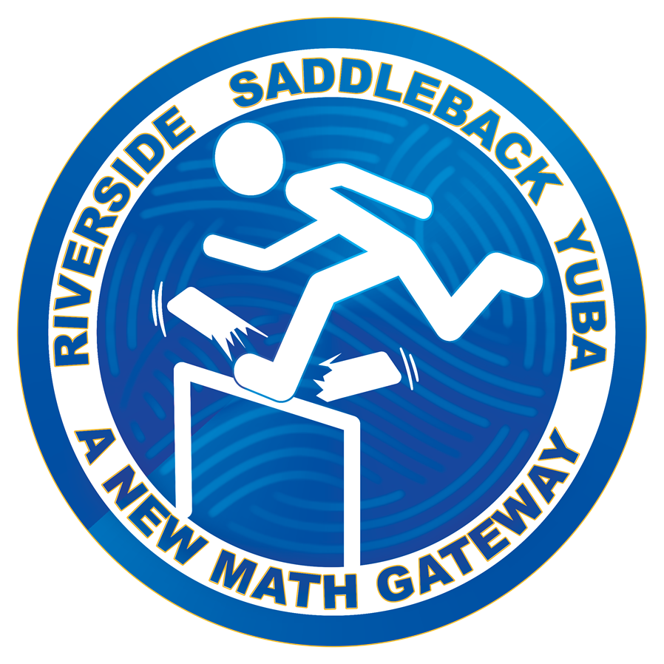
A New Mathematics Gateway ( Saddleback College, Yuba College, UC Riverside)
This project will utilize spatial learning strategies, foster growth mindset through adaptive technology, and develop an e-Book to implement a novel series of principle-based calculus concepts with revised content, video tutorials, and active learning pedagogy.

Slide 7
Equitable Calculus for Life Sciences ( LA Mission College, LA Valley College, CSU Northridge)
This project will develop a new calculus for life sciences course that incorporates culturally responsive pedagogy, contextualization of mathematical content, active and adaptive learning, gamification, and utility value (UV) interventions.
Calculus Island: The Rescue
https://studio.libretexts.org/h5p/16797
Return to Calculus Island: The Serum
https://studio.libretexts.org/h5p/14887

Slide 8
Calculus for Life Sciences Materials
Find on Canvas Commons: search for Calculus for Life Sciences look for the logo
•Calculus course contextualized for Life Sciences
•Life sciences motivation for every topic
•Short videos for each topic
•Worked out examples your own notes
•Contextualized worksheets for each topic
•Test yourself/Homework sets on MyOpenMath
Escape-room games with Calculus problems woven into the story line.

Slide 10
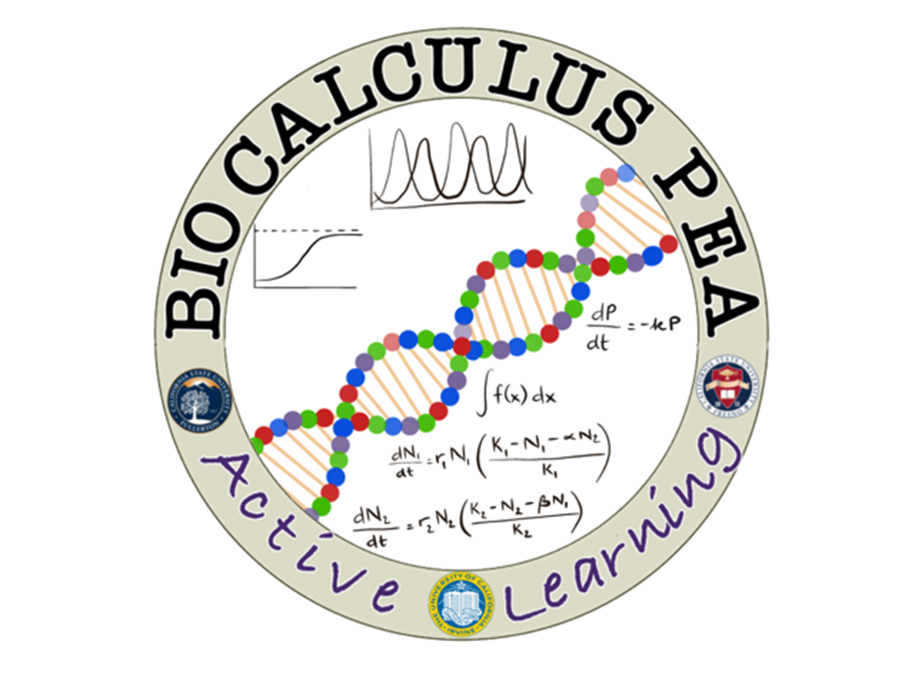
BioCalc PEA: Preparation, Engagement, Application (UC Irvine, CSU Fullerton, CSU Fresno)
The BioCalc PEA program will will provide first-year experiences (FYEs) and Summer Academies, develop a revamped BioCalculus curriculum, and incorporate Calculus-based mathematical modeling and computation into several upper-division BioSci courses.

Slide 11
BioCalc PEA:Curricular Package
•Videos by biologists & mathematicians
•Active-Learning based worksheets
•Desmos activities & data analysis with google sheet
•MyOpen Math homework questions
•Sample summative assessment questions

Slide 12
Why, What and How Calculus (UC Merced, CSU Fresno)
This project will redesign introductory calculus courses to focus on conceptual understanding and problem-solving skills by incorporating innovative approaches to teaching and learning calculus.

Slide 13
Why, What and How Calculus: Project focus

Slide 14
Introducing LLAD (LL's Asset Database)
Calculus foundational learning block for STEM Required course in first year Calculus sequence challenging Significant performance and retention gaps – URM and female
Problem:

Slide 15
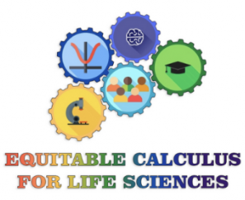
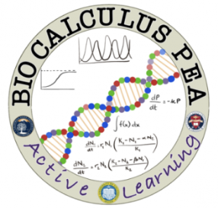
Introducing LLAD (LL's Asset Database)
The Grand Challenge Cohorts:
A New Mathematics Gateway (UC Riverside, Saddleback College, Yuba College)
Equitable Calculus for Life Sciences (CSU Northridge, LA Mission College, LA Valley College)
BioCalc PEA: Preparation, Engagement, Application (UC Irvine, CSU Fullerton, CSU Fresno)
Why, What and How Calculus (UC Merced, CSU Fresno)
C3: Convene, Connect and Collaborate (UCOP, UCLA, UCSC, CSU Monterey Bay, Lake Tahoe CC)

Slide 16
Introducing LLAD (LL's Asset Database)

Slide 17
Introducing LLAD (LL's Asset Database)
}
Assets Created:
Videos
Worksheets
Exercises, Homework Assignments, Quizzes
Lecture Slides
Active Learning Activities
Contextualized Examples
Microtutorials
Workshop materials, PD materials
Also: Full Curricular Packages
OER

Slide 18
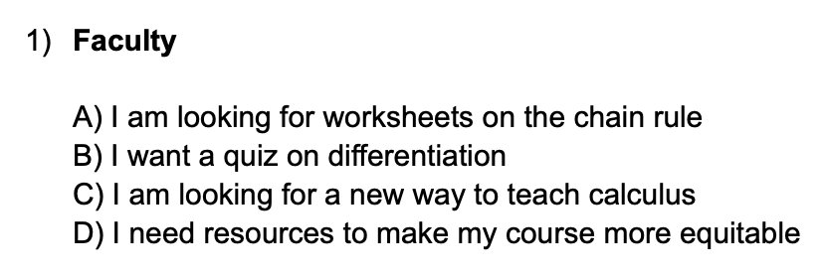
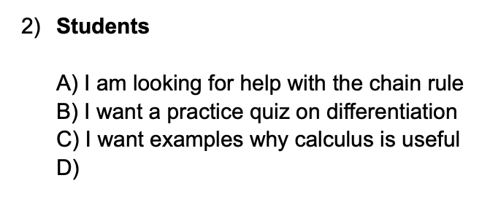
Introducing LLAD (LL's Asset Database)
Use Cases/Queries:

Slide 19
Introducing LLAD (LL's Asset Database)
Use Cases/Queries: What are YOU most interested in?
Worksheets?
Exercises, Homework Assignments, Quizzes?
Lecture Materials?
Contextualized Examples?
Resources to make your course more equitable?
Full Curricular Packages?

Slide 20
Introducing LLAD (LL's Asset Database)
Use Cases/Queries:
Would you consider using such assets?
Would you consider going to LLAD to look for resources?
What would be the assets you’d be looking to find?
What would be the queries you’d be asking?
Full Curricular Packages?

Slide 21
California Education Learning Lab
Where to find the list of projects:
https://calearninglab.org/

Slide 22
Any Questions?

