Slide 1
One Idea to Rule Them All: Teach Me Videos for Retention, Success, Equity, and Rigor.
Andre Bazos (Prof. Dre)
Pronouns: he/him/his
Contact Info: BazosA@scc.losrios.edu

Slide 2
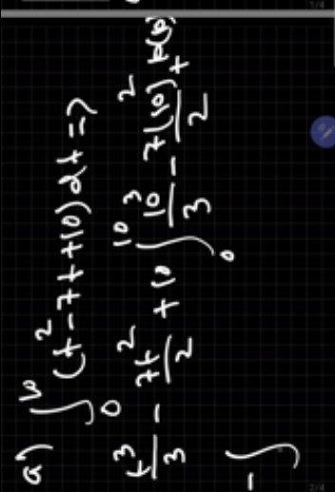
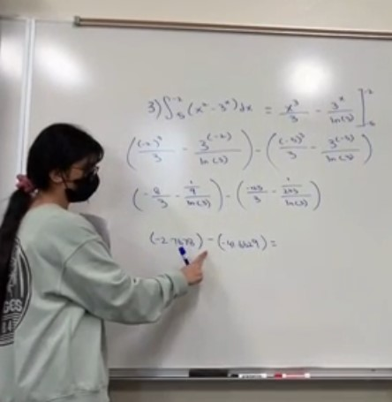
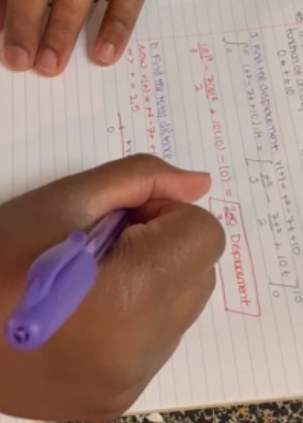
Agenda
My Journey to Teach Me Videos?
What is it? The Teach Me Video
How has it affected my Success rate?
How has it affected my Retention rate?
How is it Anti-Racist/Equitable?
How is it MORE Rigorous?
What are the other benefits?

Slide 3
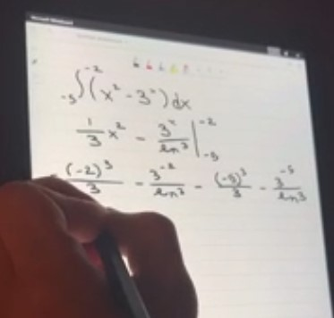
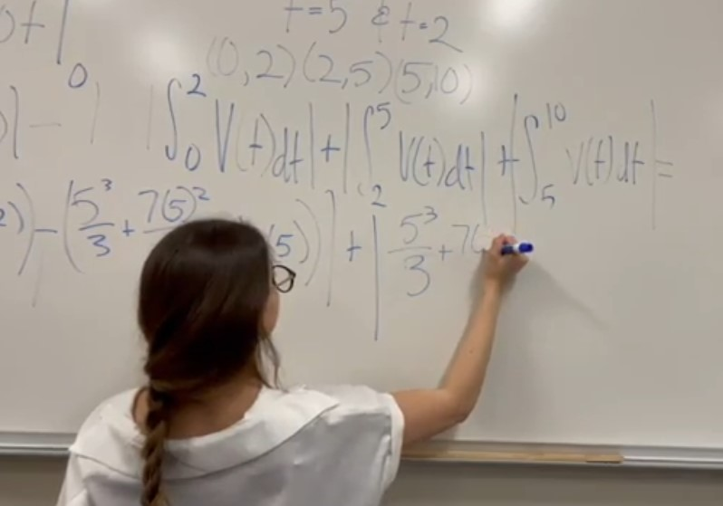
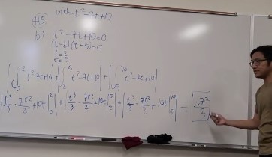
My Personal Education and Work Journey to Teach Me Videos
Earned a Masters in Math and Teaching Math from UC Davis in 2007.
CRC (Consumnes River College) from 2007 – 2014
Sierra College Tenured Track Faculty 2014 – 2019
Sac City College 2019 until present.

Slide 4
Who Supported me Through my Journey to Teach Me Videos
Many helpful faculty at CRC
Openness to sharing resources and not to be afraid to explore educational technologies.
Sierra Tonya Times and Sandi Escobar
Equity journey began here
Story about may unequitable biases
Schedule Assignment
Sierra Ken Jonson and then Mike Waterson
Taught me collaboration is not only fun but it’s the way we have hard conversations about what we teach and why.
SCC Haynalka Caton, Karla Rojas, Michelle Poliseno, Tricia Sanford, and Angie Lambert
These people got me to these ideas and kept me sane over the course of Covid.

Slide 5
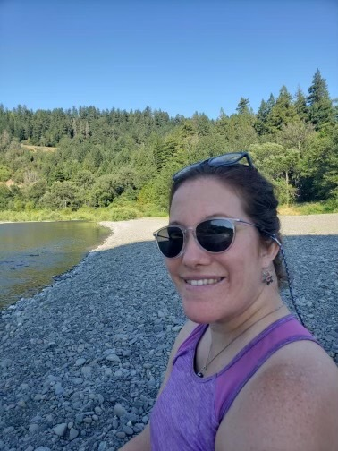
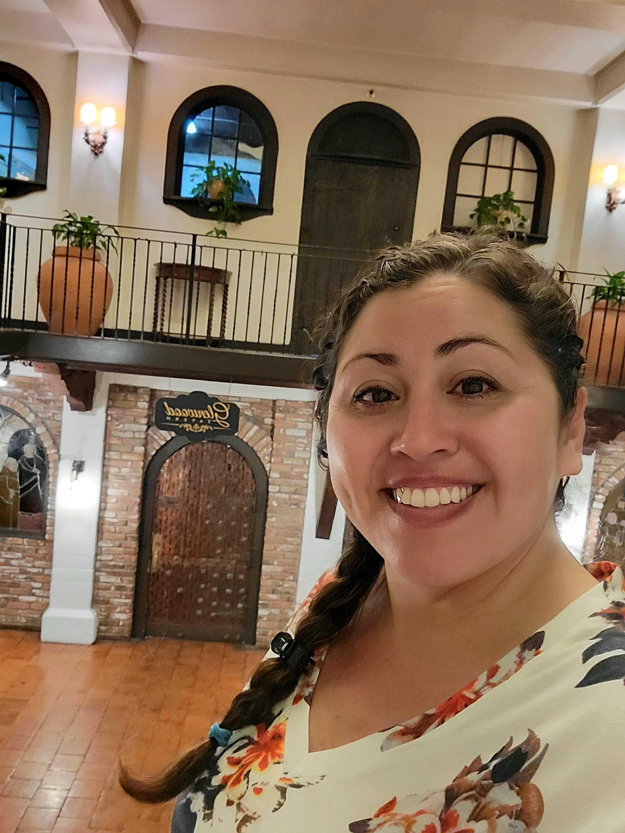
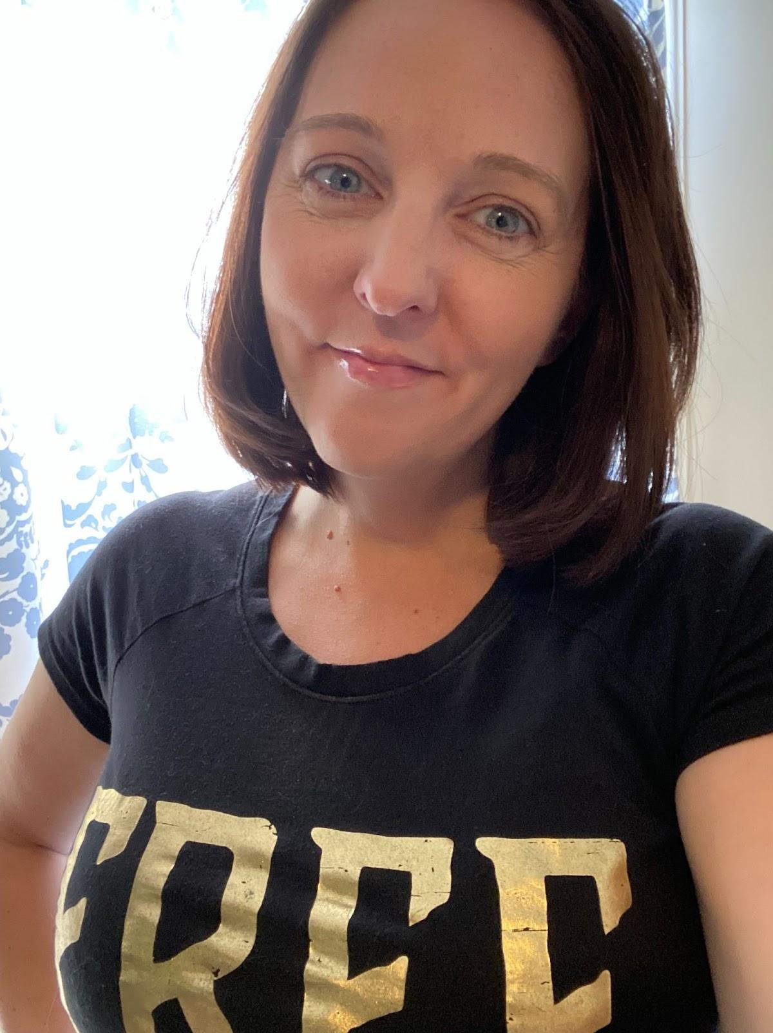
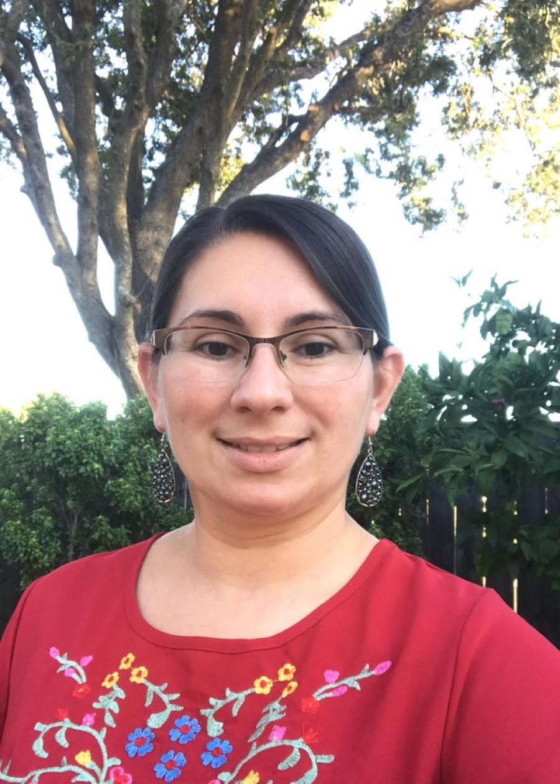
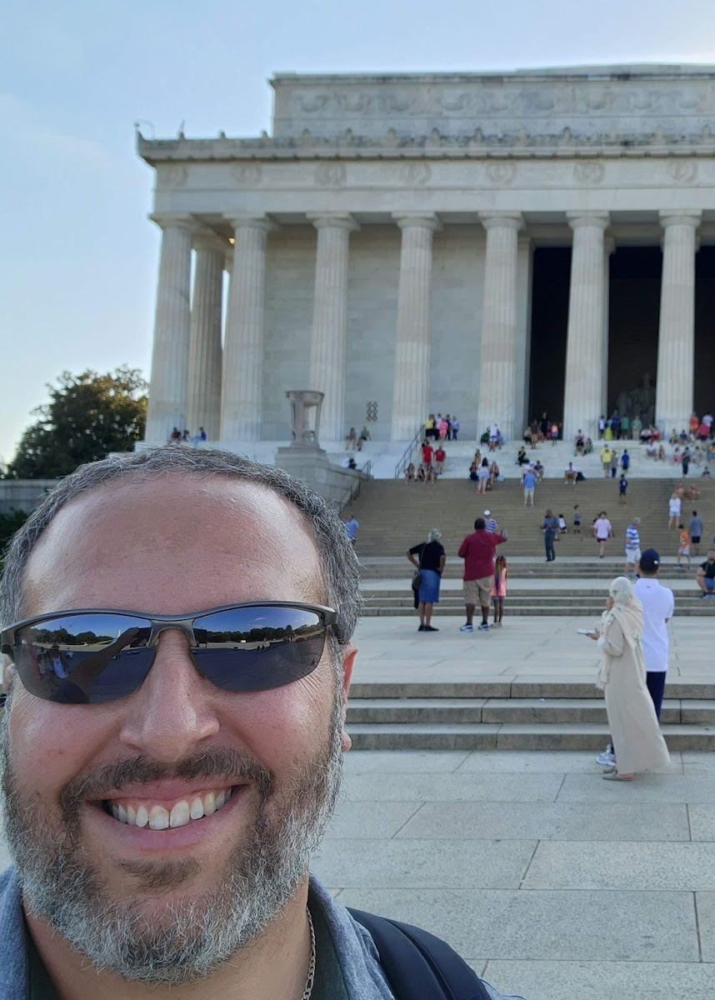
Who are we?
Karla Rojas
Haynalka Caton
Tricia Sanford
Michelle Poliseno
Andre Bazos
Sacramento City College Mathematics Professors

Slide 6
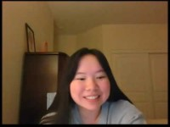

Well? What the hell are they?
Teach Me Videos are just simply that… all my students must Teach Me one problem each week on a video.

Slide 7
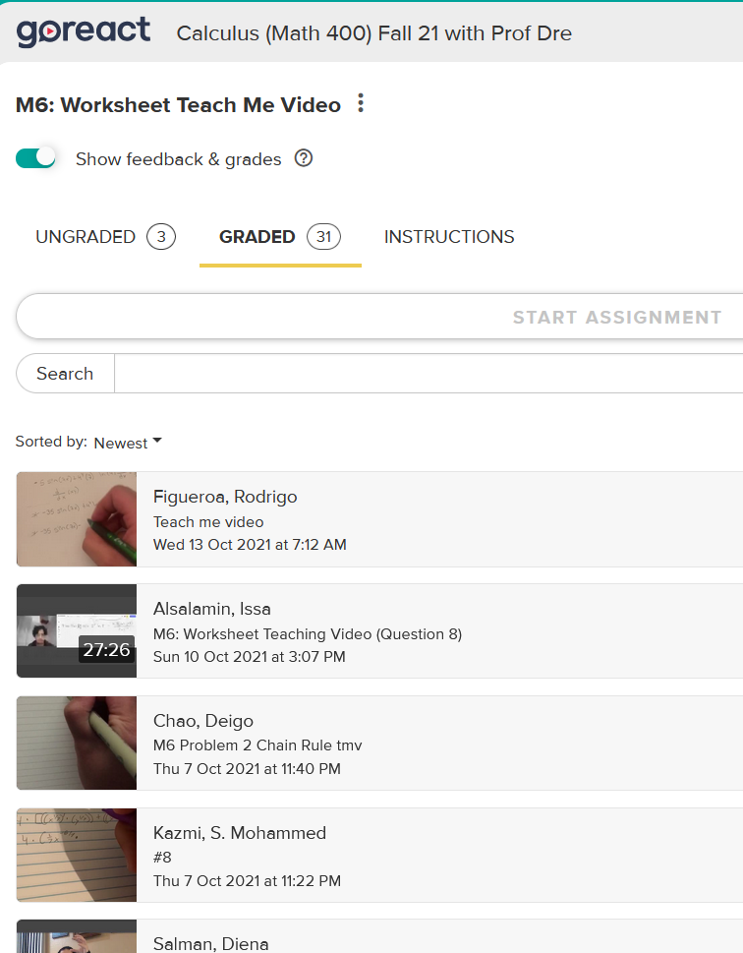
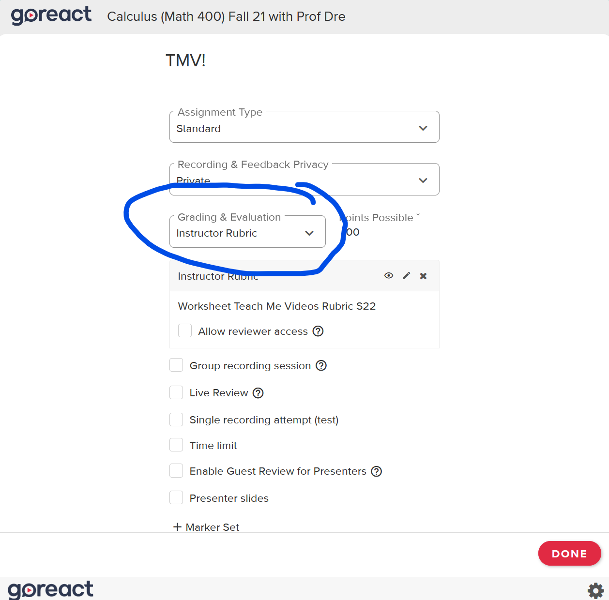
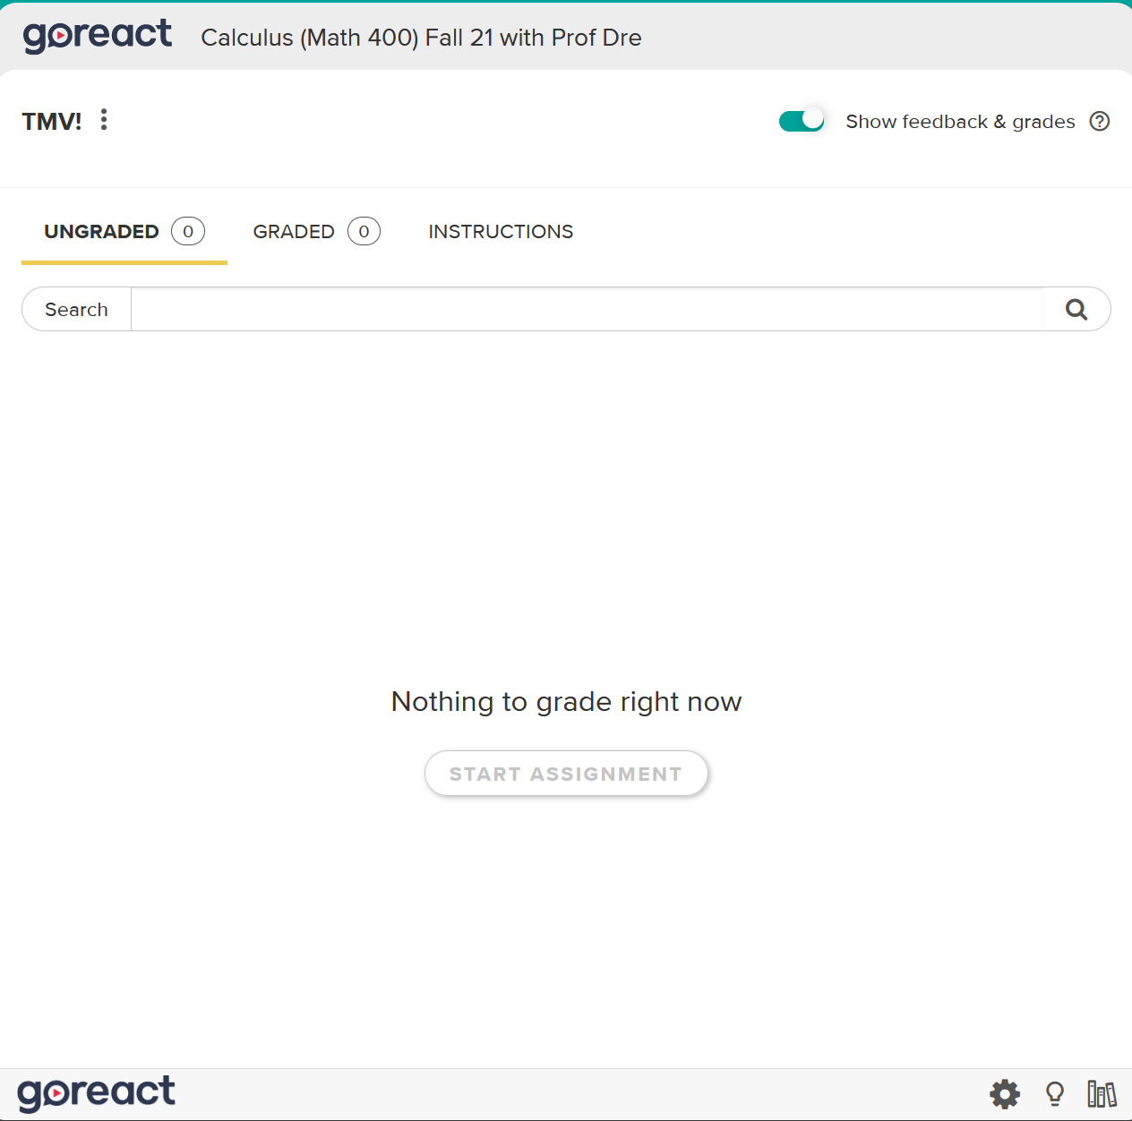
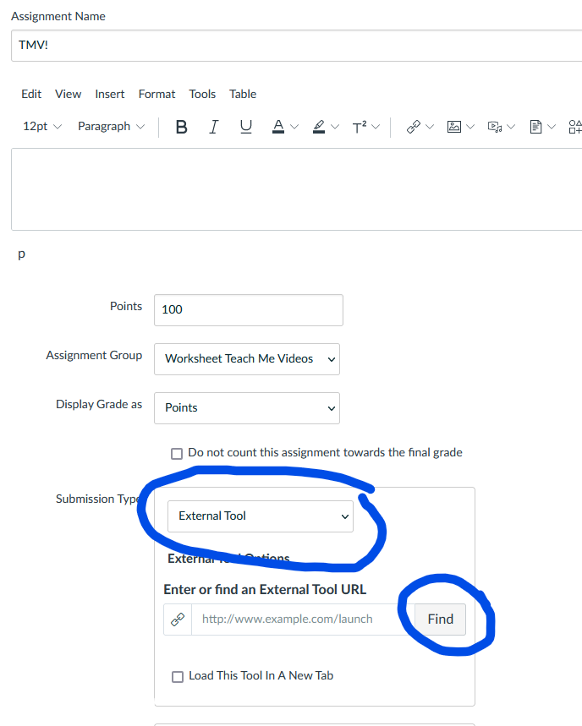
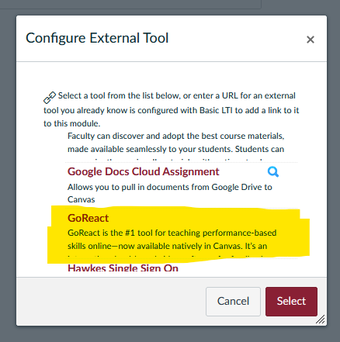
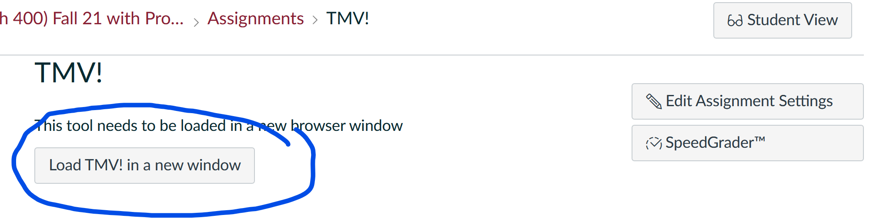
What do you use and how do you assign them?
GoReact is the apps that is in Canvas. This is an easy tool to use in Canvas.

Slide 8
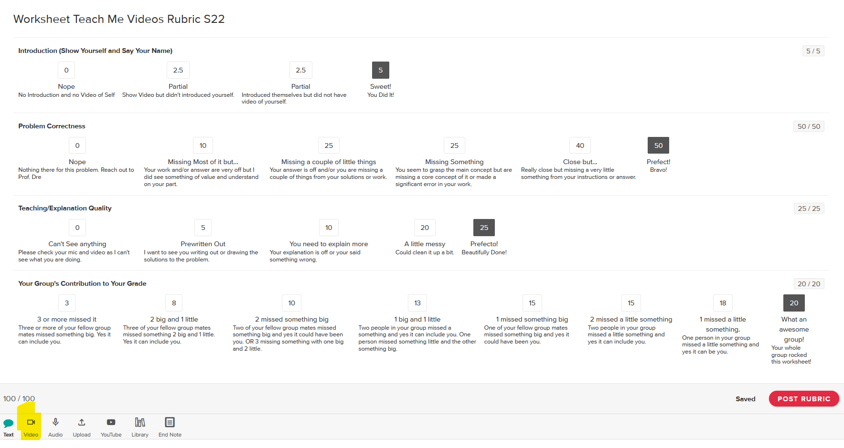
How do you grade them?
Note: You can allow redo's for points back.
Use GoReact’s Rubric, Use Double Speed, and Video Feedback to tell them exactly where they nailed it and of course where they didn’t.

Slide 9
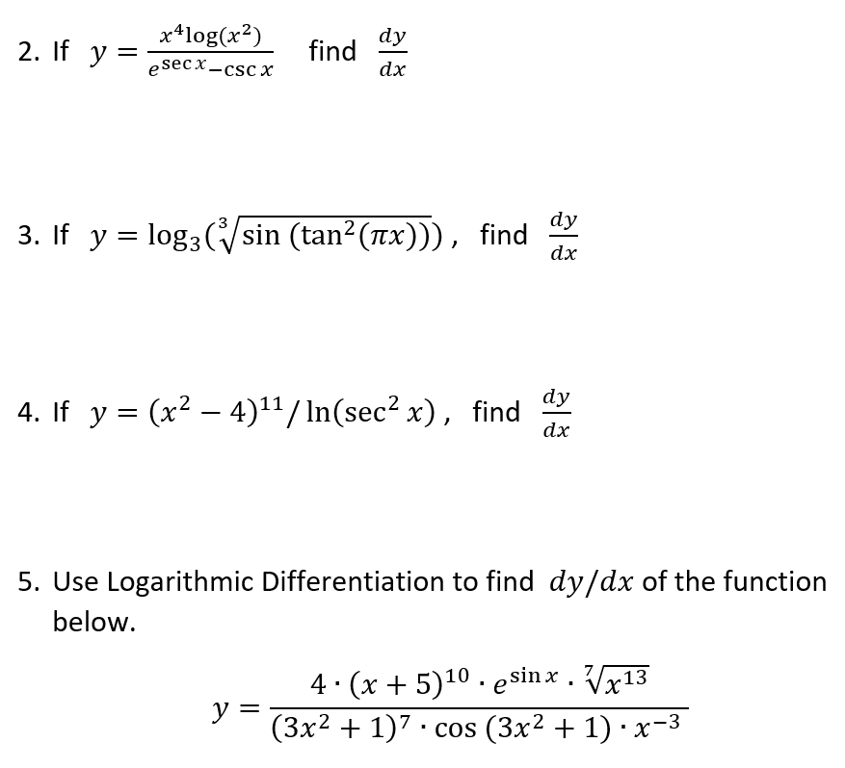
But why should I want to do them?
Increased Retention
TMV Retention for all Completed TMV classes: 62/69 = 89.9%,
TMV Retention for all TMV classes: 119/135 = 88.1%,
  Pre – TMV Retention for all my Non-TMV classes: 161/210 = 76.2%,
Retention for my current Stats classes: 57/66 = 86.4%,
  Pre – TMV Retention for past Stat courses: 136/175 = 77.7%
Increased Success
TMV Class Success Rate in Fall 2021: 31/32 = 96.9%
  SCC’s Fall 2021 Success Rate: 68.1%
  SCC’s Math Department Fall 2021 Success Rate: 58.6%
TMV Class Success Rate in Spring 2022: 26/30 = 86.7%
  SCC’s Spring 2022 Success Rate: 69.8%
  SCC’s Math Department Spring 2022 Success Rate: 58.6%
Current TMV Class Success Rate: 45/66 = 68.2%
Increases Rigor
TMV Class Success Rate for my Fall 2021 Calculus 1 students that Passed Calculus 2 in Spring 2022: 18/23 = 78%
  Success Rate for Fall 2021 Calculus 1 students at SCC that Passed Calculus 2 in Spring 2022: 76%
Made harder problems and now they have to teach it to me! That’s Rigor!
Other things to mention:
Increased Participation
They literally must participate, even the quite ones.
Increase Relationships with your students
I have a conversation with them every week
Know all of them and their strengths and weaknesses
Again, they literally must participate

Slide 10
How is it Equitable/Anti-Racist?
Through the many many many workshops, conferences, equity summits, and programs I attended a couple of main themes kept popping up.
Get to know your students
Have them get to know you
Flip the class
Do group work
So, The TMVs do this and more to help close your equity gaps by…
Get to know your students.
They get to know you.
All students must participate. No student left behind.
Group work – student to student interaction.
Just-In-Time Remediation!
They can fix them!
Non-Disposable Assignments can be made.

Slide 11
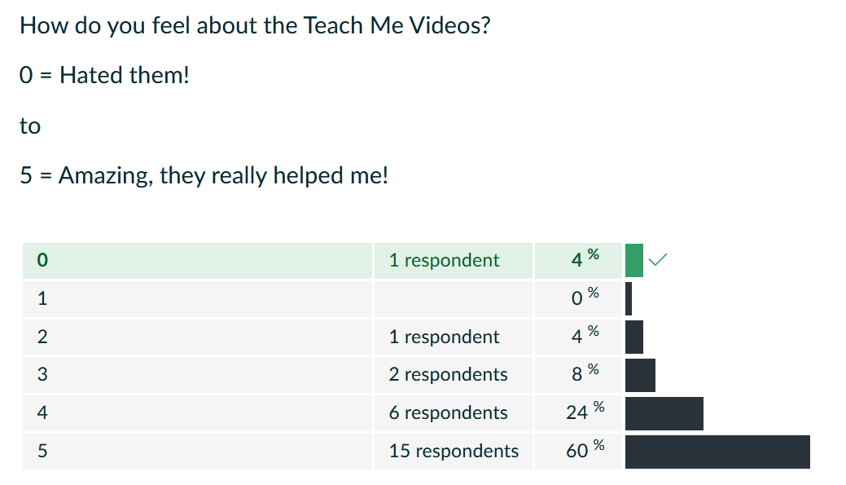
What do the students think?
Nervous at first but they can really get into them.
I thought that the class was well structured, and your instruction was among the best of any math teacher I have had. The Teach me Videos REALLY helped me solidify my understanding of calculus and how different topics fit in with each other. Overall, I would say that this is one of the best math classes I have ever taken.
This class was way better compared to any of my past math classes I have taken. You went into good detail with the notes along with explaining any questions we had with some of the MOMs. I feel like this combination led to great success for me on the exams as I knew based on worksheets, notes, and MOMs what would be on the exam. Although at first I hated the TMVs as it got later into the semester I found that they could be useful.
I wouldn't say I liked TMV at first. I was not too fond of group projects and making videos. But at the end of the semester, I gradually found TMV is a good method to study and connect with classmates. When I made my TMV, the problems I needed to solve became clearer in my mind and became problems that I really mastered. This math class is the only class that gives me a chance to communicate with my classmates (it is tough to communicate with your classmates in CC) I also like the simultaneous online and offline, which I think is a new way of teaching after the pandemic. This teaching method gives me a lot of conveniences. It takes me two hours to commute from home to school and back, so online teaching saves me time. But sometimes, I want to communicate with my classmates, and going to the college campus is also a good choice. After all, thank you, Professor Dre! Thank you for an excellent course and innovative way of teaching this semester.

Slide 12
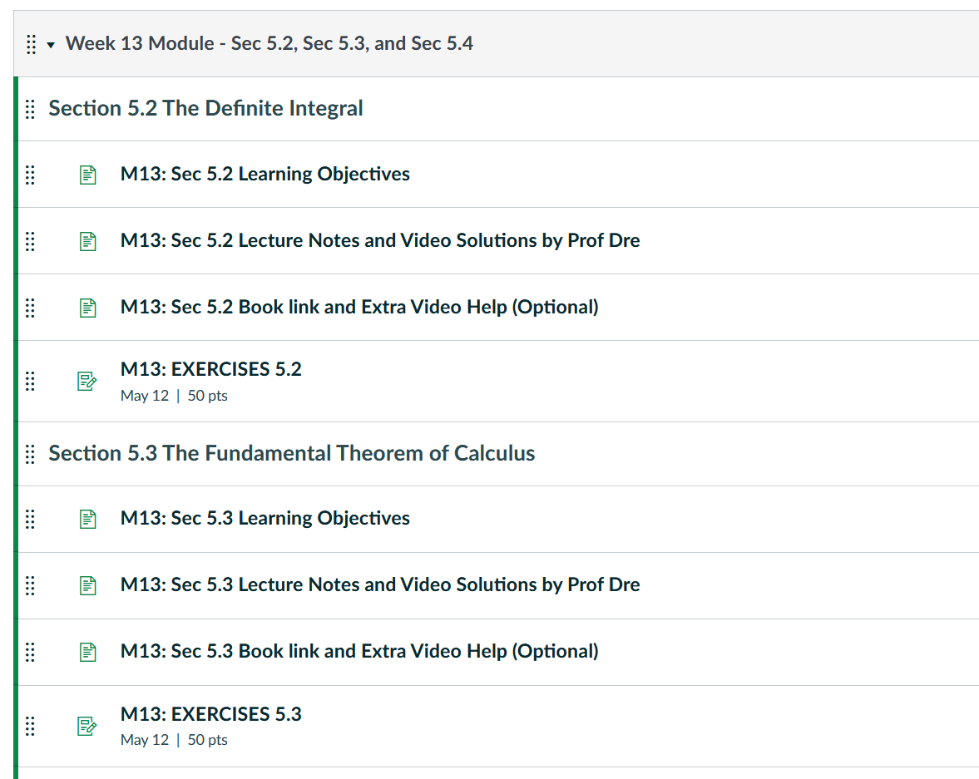
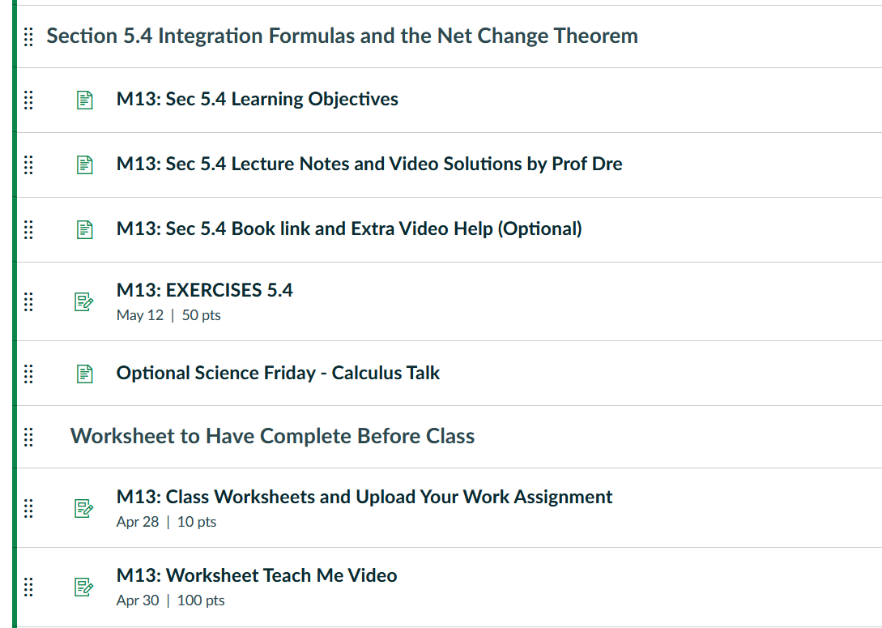
Structure of my Calculus 1 Course

Slide 13
Yes, there is a lot of Good stuff, but…
GoReact is great if you have a decent PC, but not as good for Macs or Chrome Book.
I have to help my students with tech issue, particularly in the beginning.
Yes, student’s videos are sometimes not good enough quality.
The Digital Divide is something to be concerned about here.
Yes, they can take a long time to grade.
To set up a Canvas course like my Calculus course is a lot of work.

Slide 14
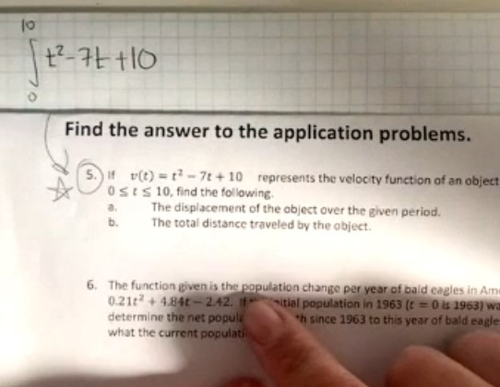
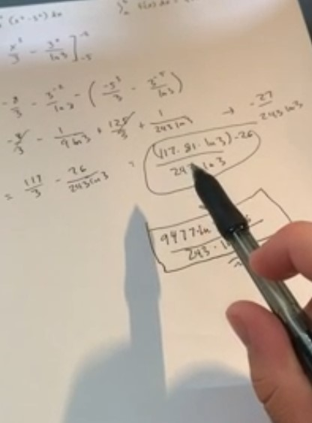
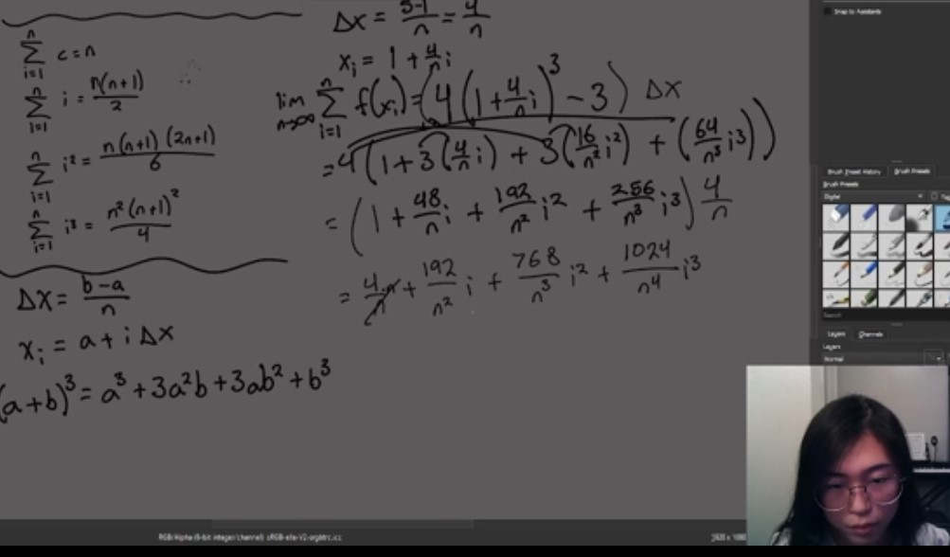
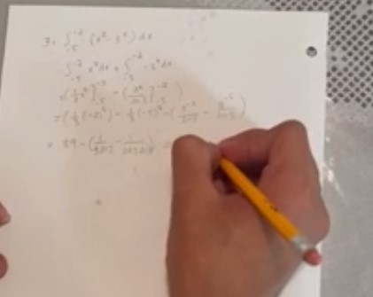
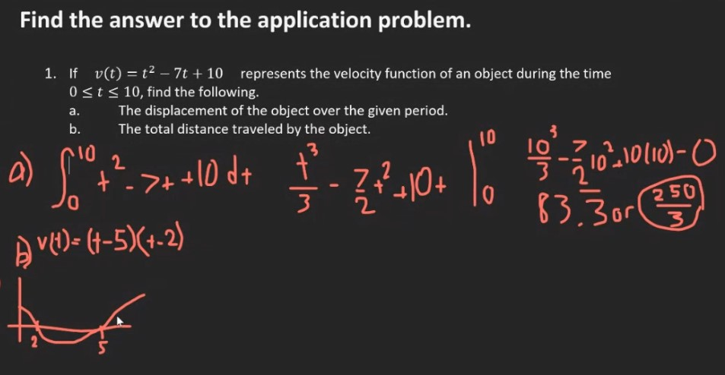
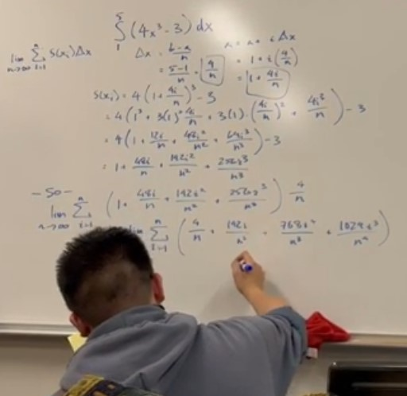
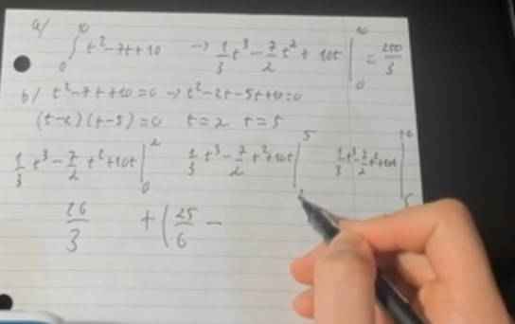
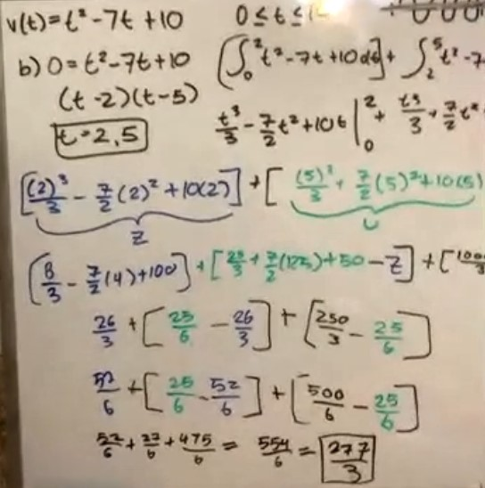
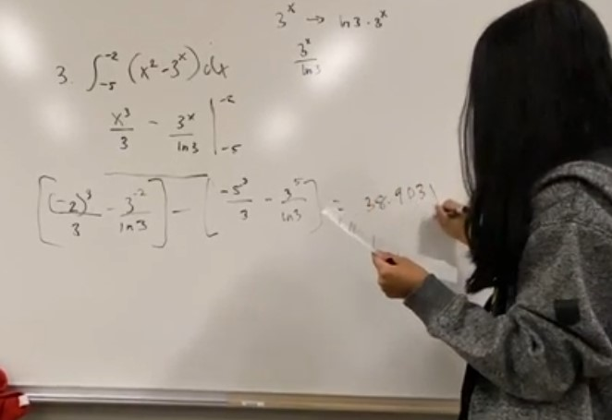
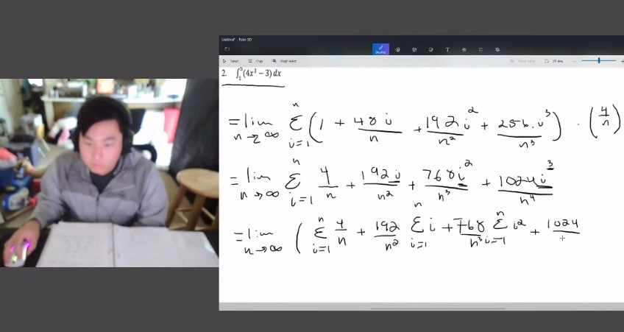
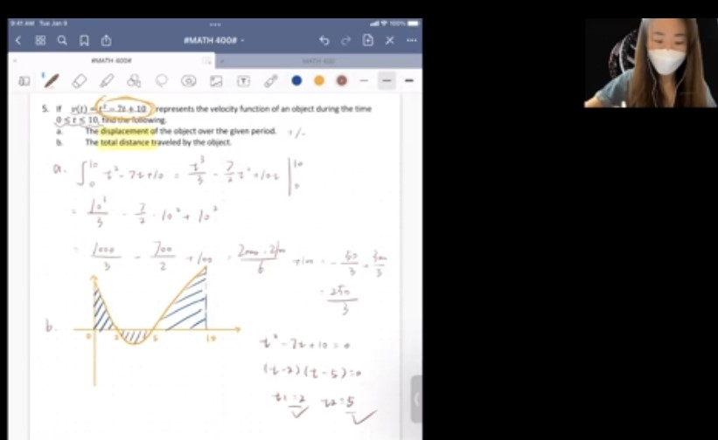
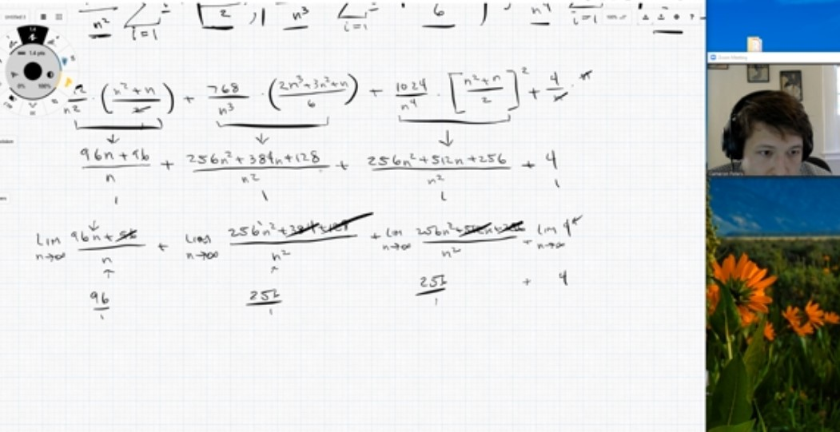
Free, Rigorous, & Equitable Calculus 1 Course with Teach Me Videos
Taking this class with you made me absolutely love math! The once terrified college freshman who was insecure about their mathematics skills is now confident about taking higher-level math courses and doing well in them - thanks to you and your teaching style. The Teach Me Videos, in particular, were extremely helpful as you would have to know very well what you're talking about (why the correct answer is correct and the process of solving it) before you teach how to do it. I really enjoyed this class and had lots of fun learning math.
Try my Calculus 1 Course that is in Canvas Commons, just look up Bazos. Note: I’ll have a Statistic class up by the end of the semester. THANK YOU!

