Slide 1
Using Real Population Data to Illustrate Difficult Statistical Concepts
Michael Sullivan
Joliet Junior College
msulliva@jjc.edu sullystats@gmail.com https://www.sullystats.com

Slide 2
Distribution of the Sample Mean Home Runs in 2019
https://baseballsavant.mlb.com/statcast_search

Slide 3
USING STATCRUNCH THIS!
Webscraping Tool

Slide 4
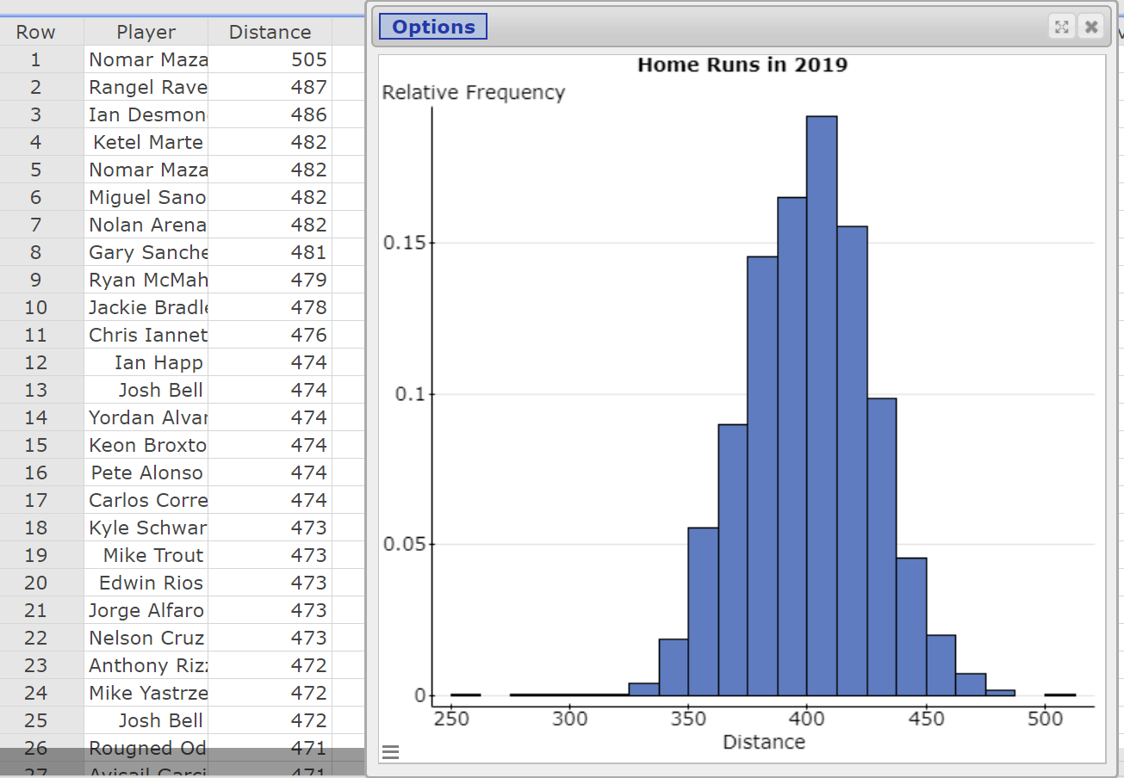
Notes:
I used StatCrunchThis! from StatCrunch to extract the data from the webpage. The data drops right into a StatCrunch spreadsheet. Show this process.
1. Data > Row Selection > Detect > Empty Select Column “Results”.
2. Edit > Rows > Delete

Slide 5
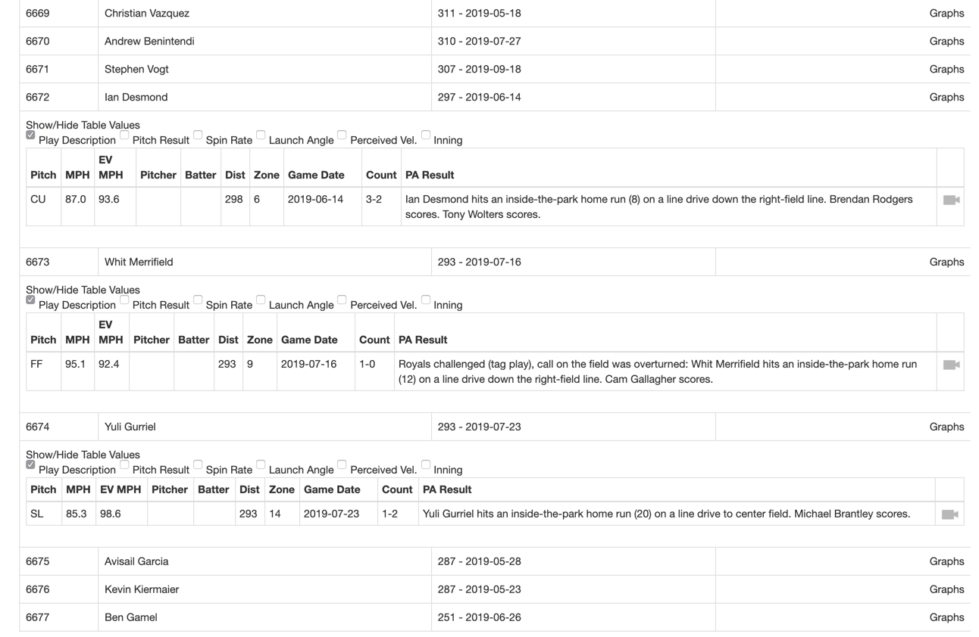
Notes:
Clean up the data by removing “inside the park” homeruns.

Slide 6
THE NORMAL MODEL

Slide 7
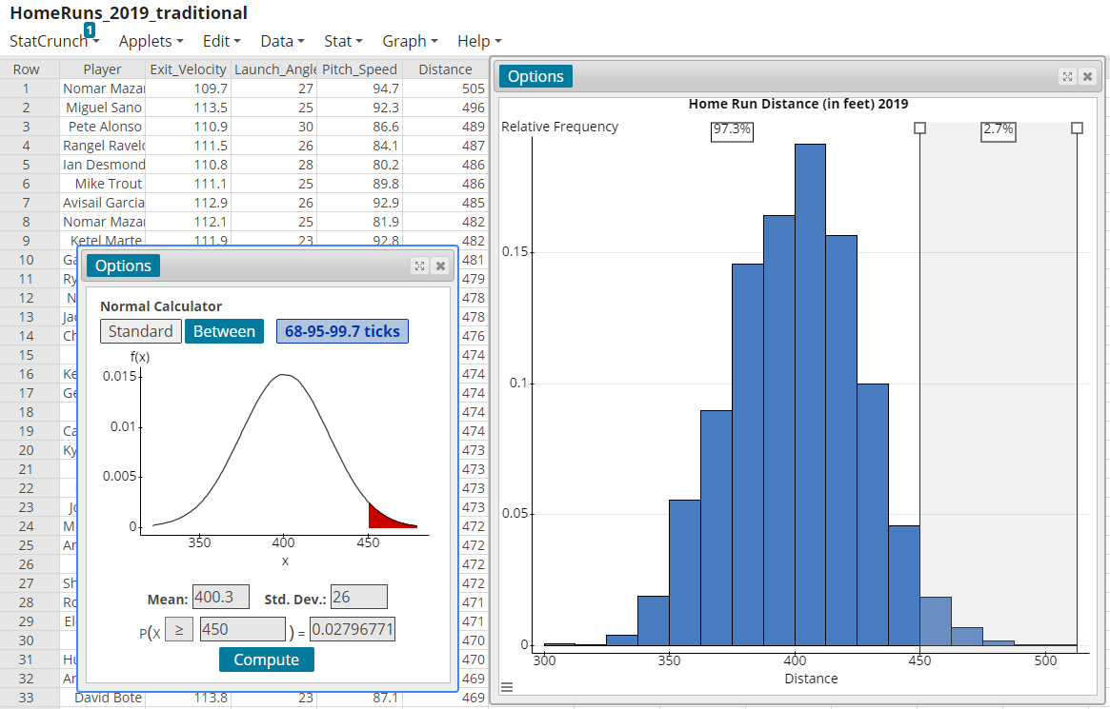
The Normal Model

Slide 8
SAMPLING DISTRIBUTIONS
Using R

Slide 9
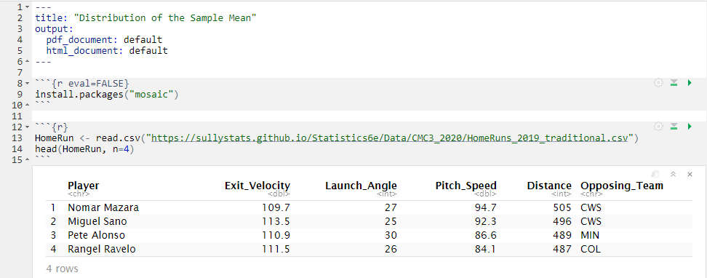

Slide 10
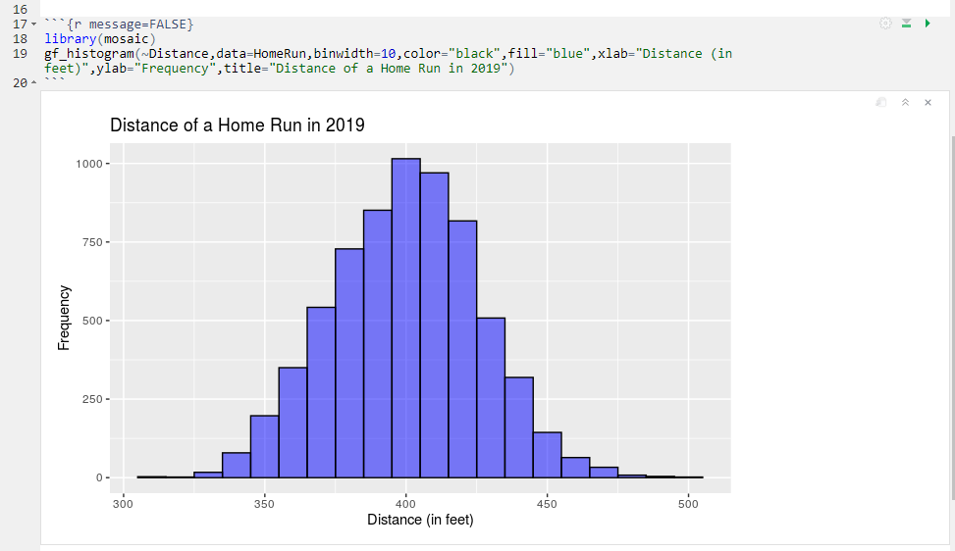

Slide 11
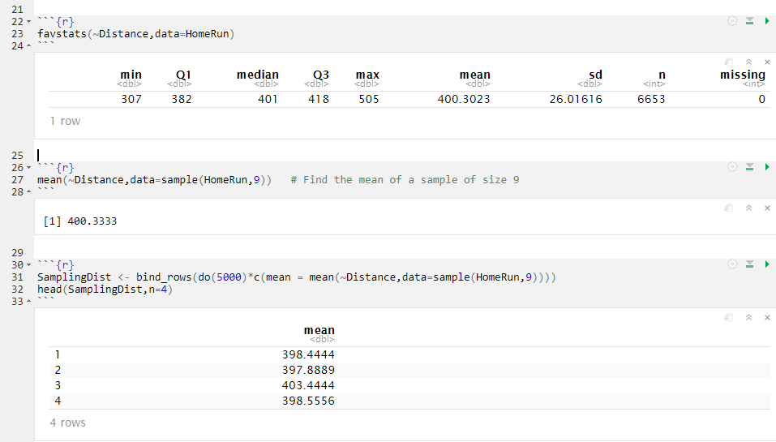

Slide 12
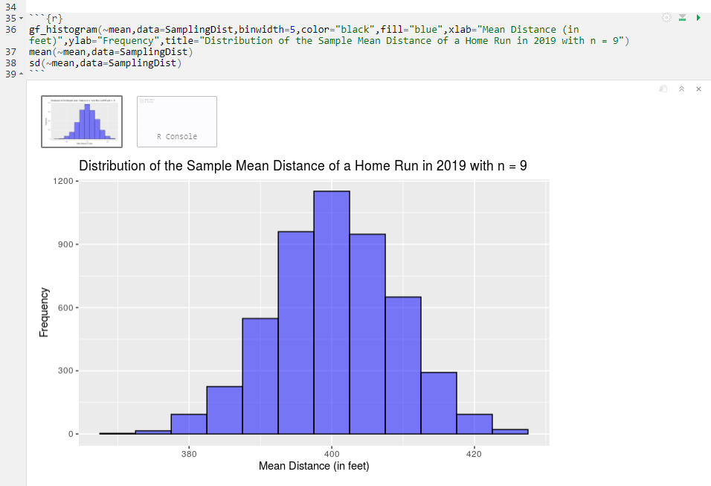

Slide 13
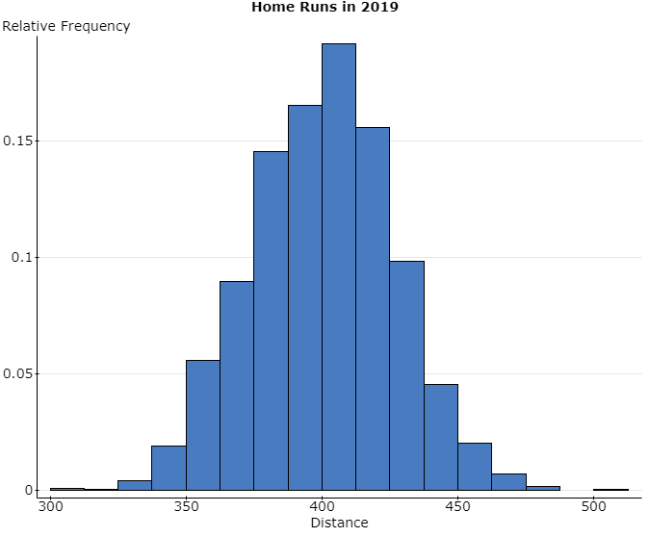
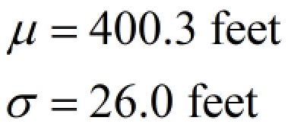
Notes:
To do this in StatCrunch:
Step 1: Have raw data in column 1. Select Data > Sample. Choose the column that has the raw data under “Select columns:”. Choose a sample size and number of samples (recommend at least 2000). Check the radio button “Stacked with sample id”. Open in a new data table. Click Compute!
Step 2: Select Stat > Summary Stats > Columns Choose the column with the sample data under “Select columns”. Choose Sample under “Group by”. Select the Mean under “Statistics”. Store in data table should be checked. Click Compute!. Note: A popup will appear asking you to bin the data. Cancel this.
Step 3: Now draw a histogram of the column Mean. Find the Mean and Standard deviation of the variable Mean.

Slide 14
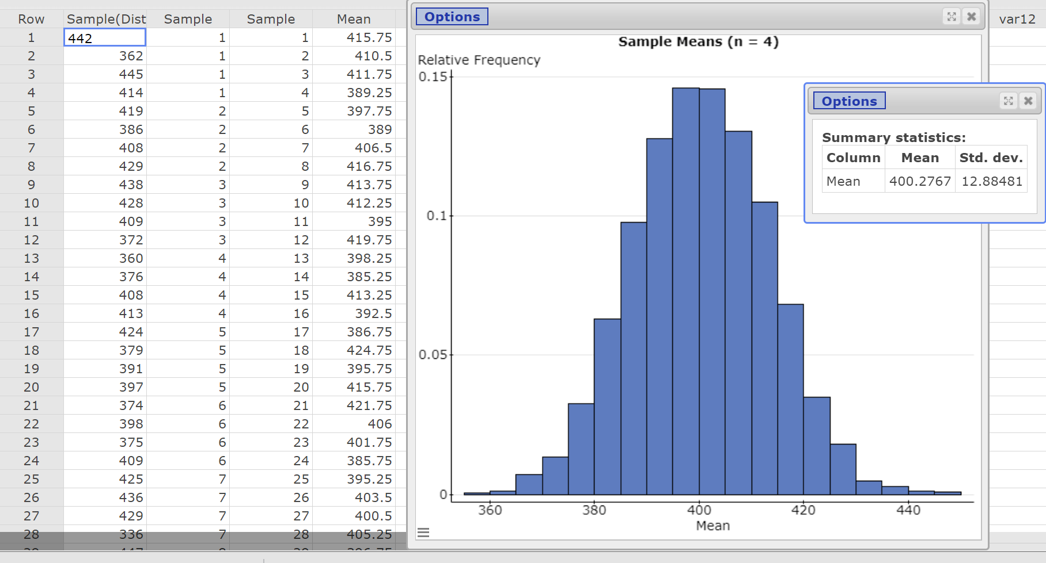
Notes:
This is a random sample of size four from the population obtained many (independent) times.

Slide 15
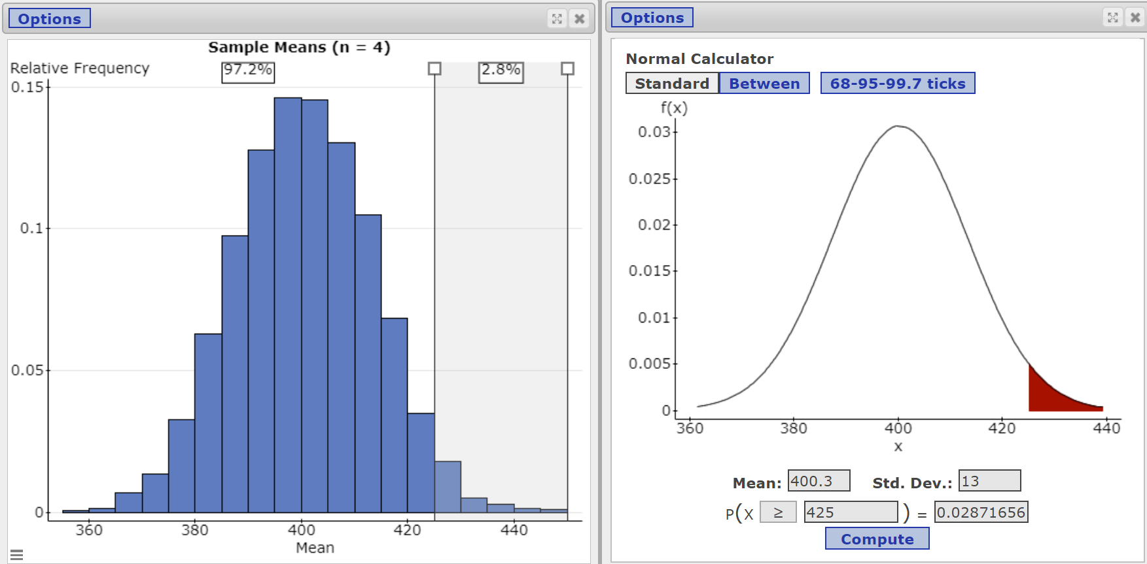
Notes:
Compare the proportion of samples whose mean distance exceeds 425 feet using the simulated data to the proportion obtained from the normal model.

Slide 16
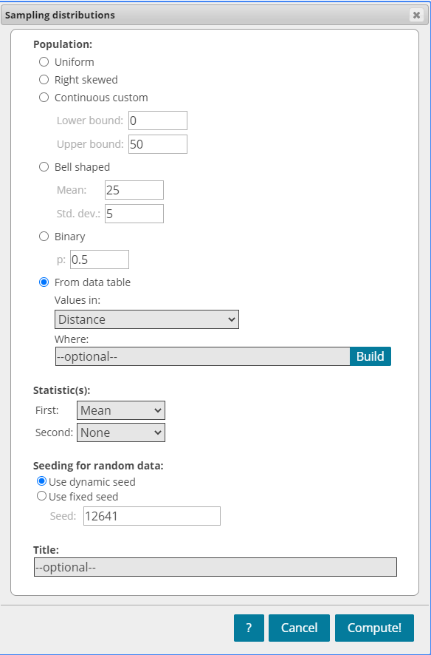
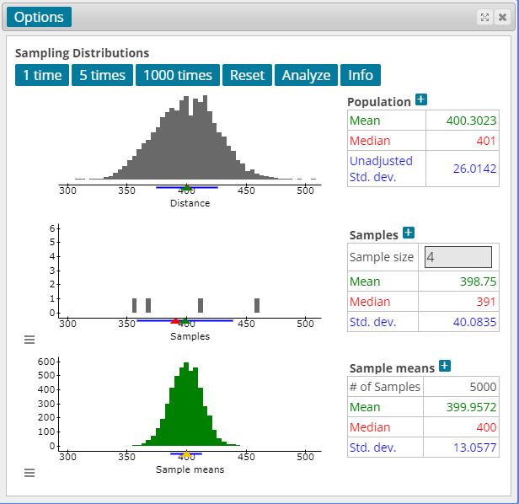
Notes:
Applets > Sampling distributions

Slide 17
https://sullystats.github.io/Statistics6e/Data/CMC3_2020/HomeRuns_2019.csv
https://sullystats.github.io/Statistics6e/Data/CMC3_2020/HomeRuns_2019_traditional.csv

Slide 18
R Code https://www.sullystats.com/statistics-6e/r-guidebook/

Slide 19
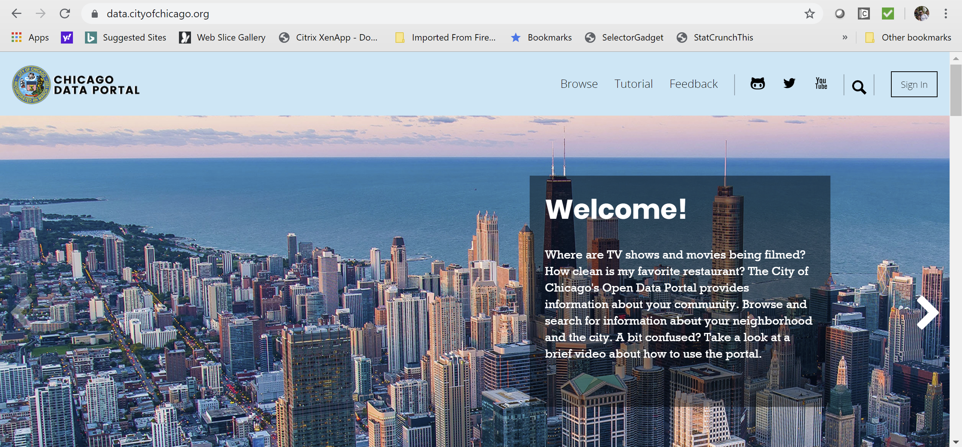
Distribution of the Sample Mean Taxi Rides in Chicago
https://data.cityofchicago.org/
Notes:
Many cities have open portals that give you access to data. Often this data is downloadable as a csv file. Show the site.

Slide 20
https://sullystats.github.io/Statistics6e/Data/CMC3_2020/Taxi_Chicago_June7_2019.csv
https://sullystats.github.io/Statistics6e/Data/CMC3_2020/Taxi_Chicago_June7_2019_clean.csv
Notes:
Show how to upload data from GitHub. Also, show the ability to create a group in StatCrunch and share data.

Slide 21
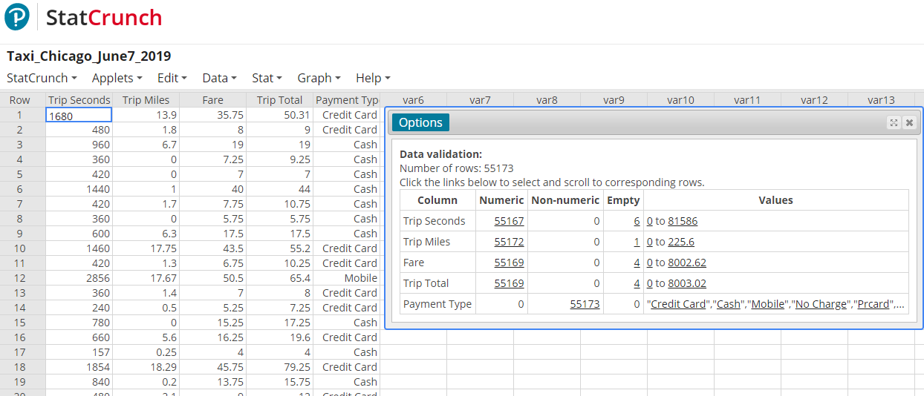
Validate Your Data
Important to explore your data prior to working with it.
Validate allows you to see empty cells and/or strange results.
Necessary to “clean up” your data.
Notes:
In StatCrunch, select Data > Validate

Slide 22
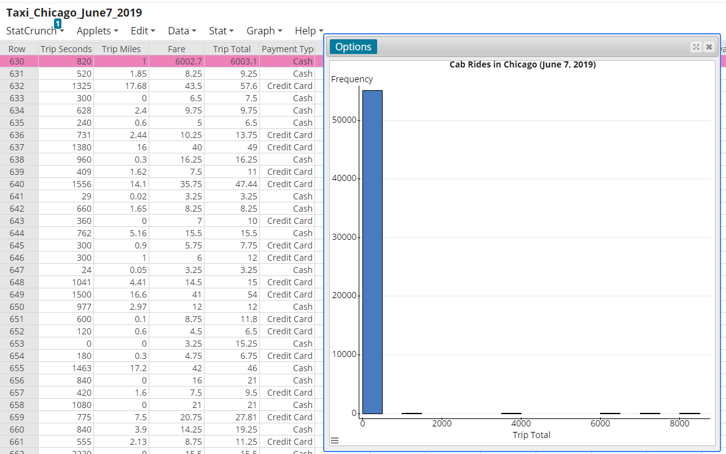
Notes:
Once again, the data needs to be cleaned up. A one mile $6000 cab ride paid in cash. Strange. Click Edit > Rows > Delete

Slide 23
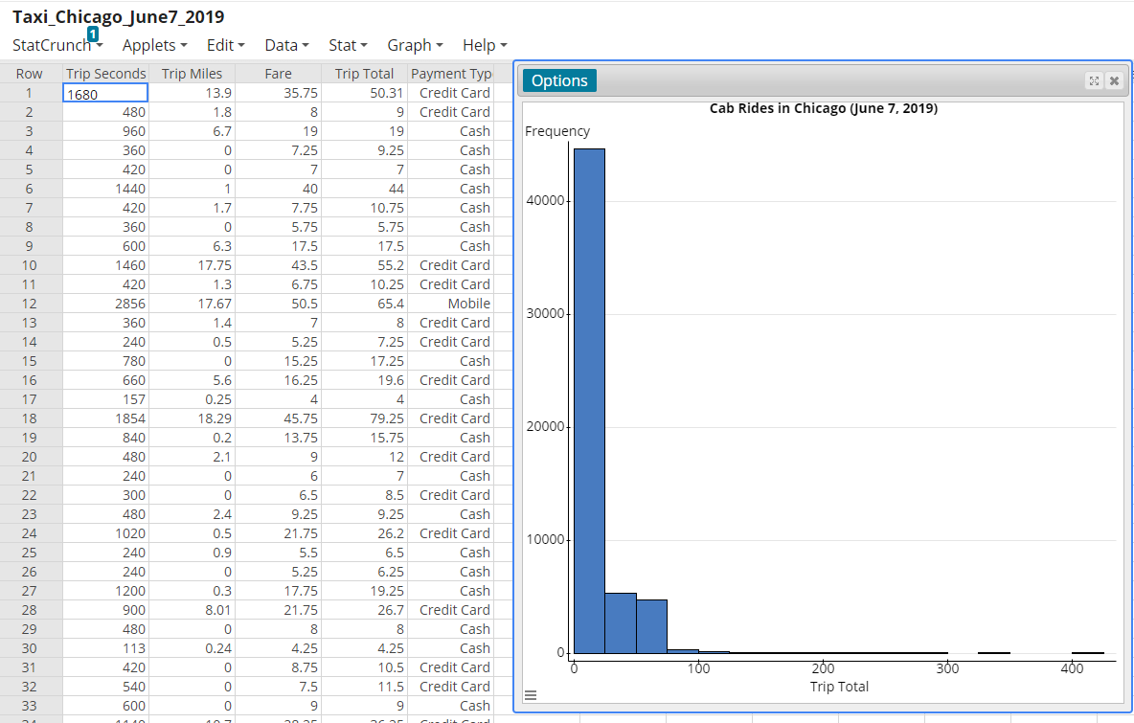
Notes:
Keep reviewing the data and cleaning it up. Highlight values up to $200.

Slide 24
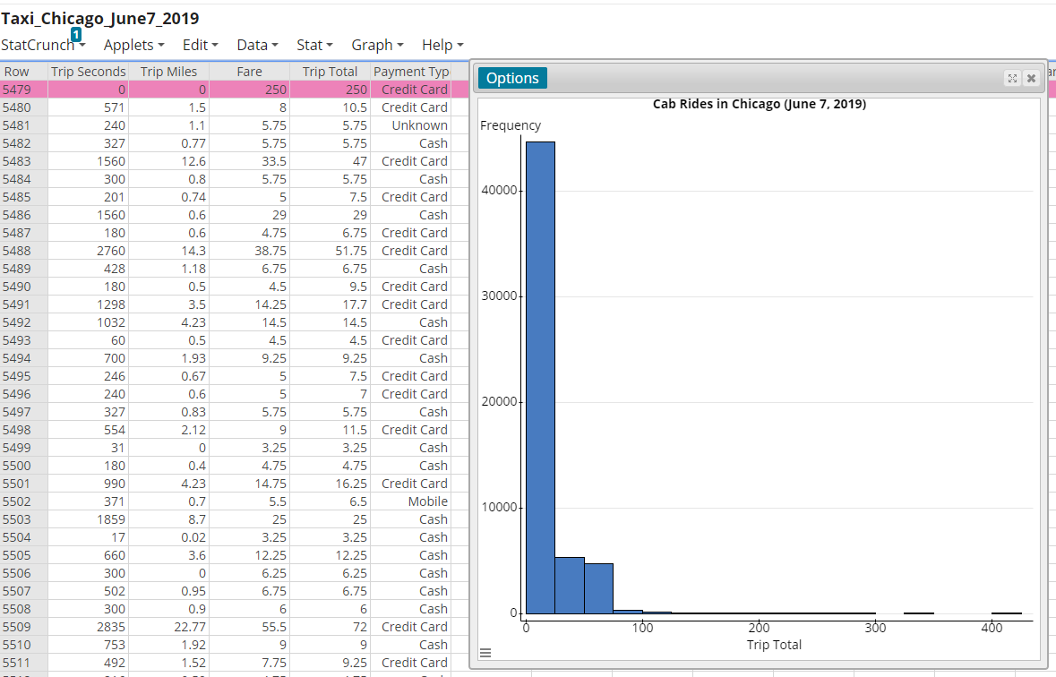
Notes:
$250 charge for a 0 mile ride.

Slide 25
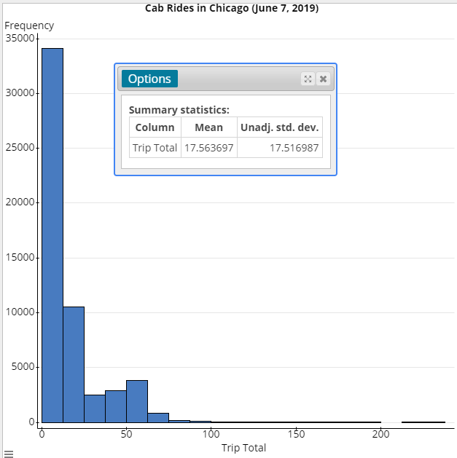
Histogram and Summary Stats
Notes:
Clean data.

Slide 26
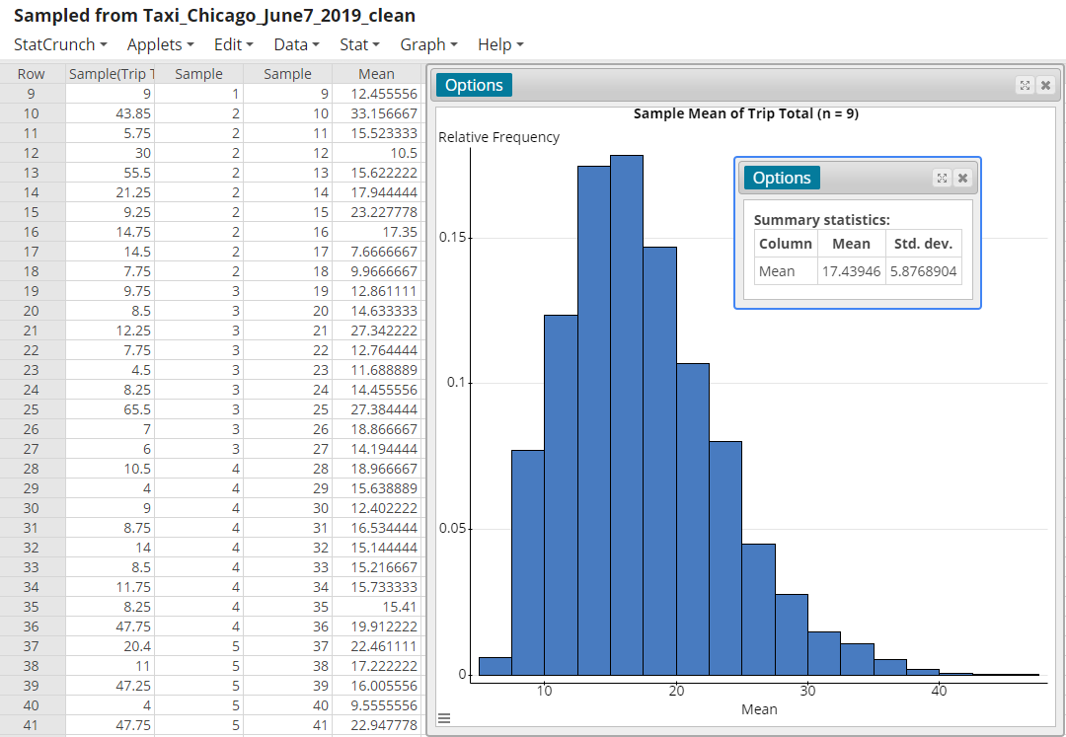
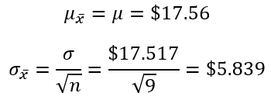
Notes:
Obtained many random samples of size n = 9 from the population. This is based on 5000 SRS of n = 9.

Slide 27
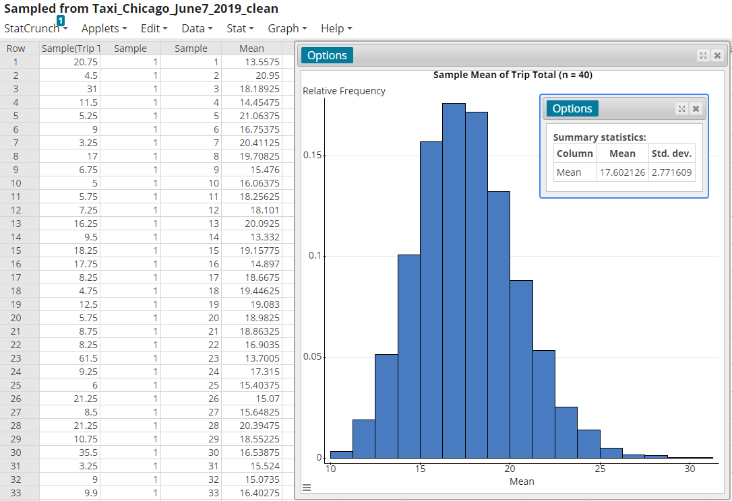
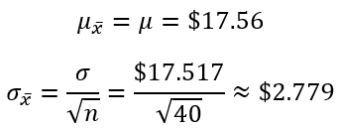
Notes:
Obtained many random samples of size n = 40 from the population.

Slide 28
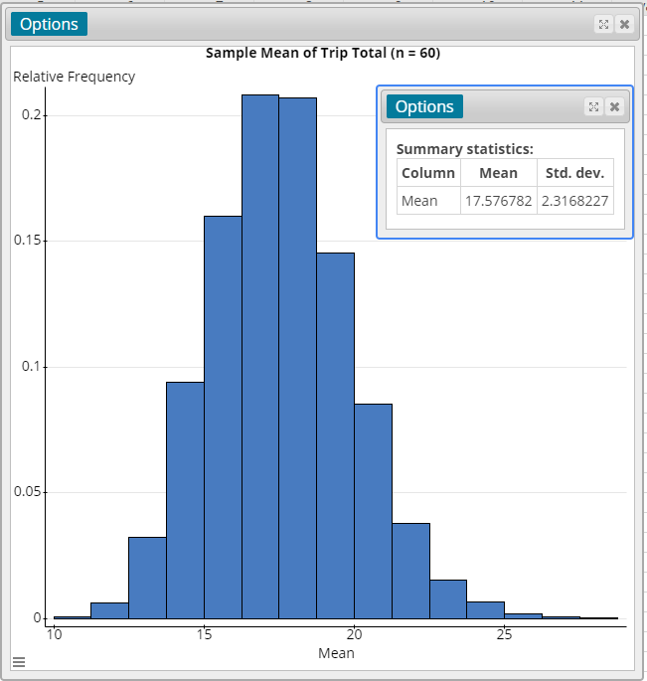
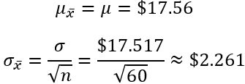
Notes:
Obtained many random samples of size n = 60 from the population.

Slide 29
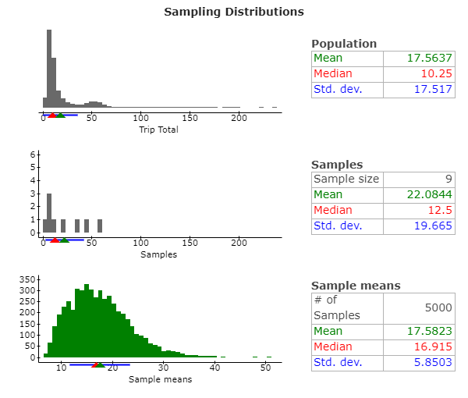
Notes:
Applets > Sampling distributions
Click the three horizontal lines in the bottom left corner to zoom in on the x-axis.

Slide 30
Tornado Data https://www.spc.noaa.gov/wcm/#data

Slide 31
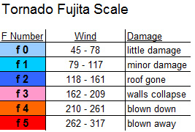
Illustrate the Meaning of Level of Confidence

Slide 32
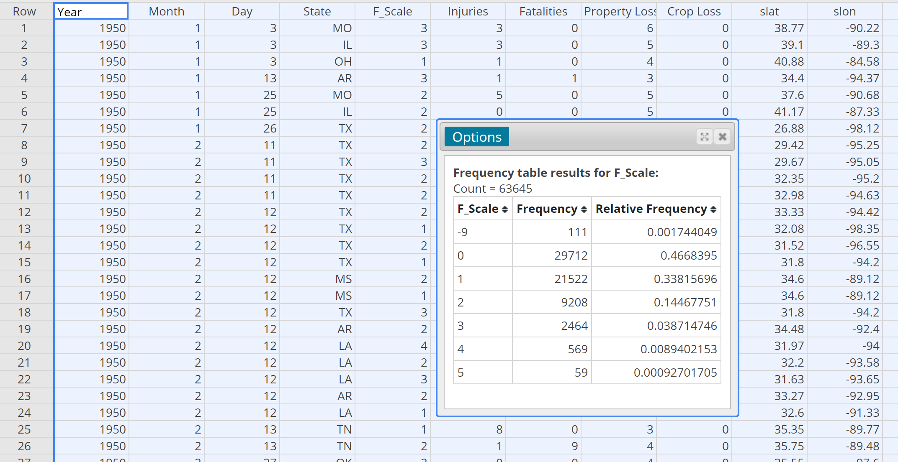
Notes:
Tornadoes whose F-Scale is -9 had an F-scale that was not reported. We will remove these observations from the data set.

Slide 33
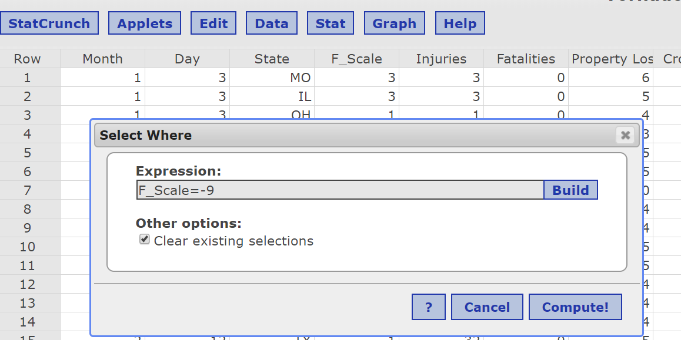
Clean Up the Data
Data > Row Selection > Select Where
Edit > Rows > Delete

Slide 34
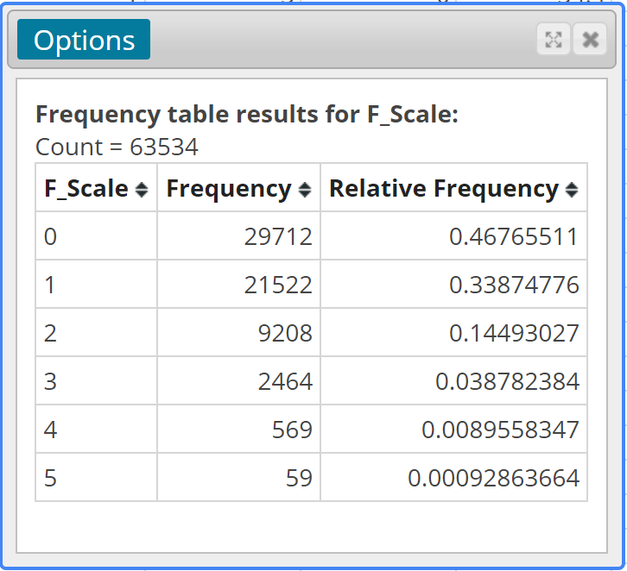
Population Proportion of F0 Tornadoes: 0.468

Slide 35
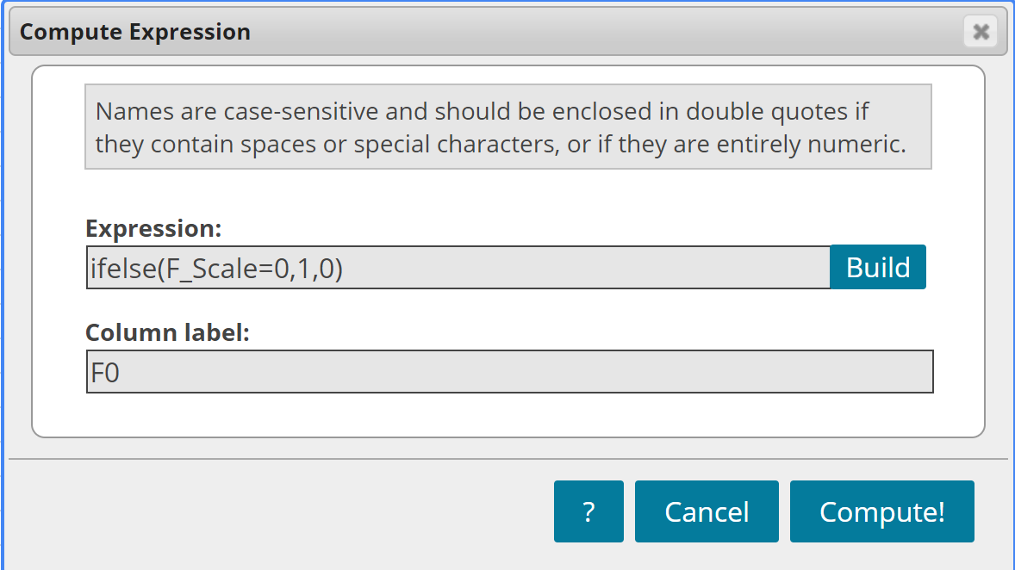
Create a New Variable
Notes:
Creating a Bernoulli random variable from the F-Scale column.

Slide 36
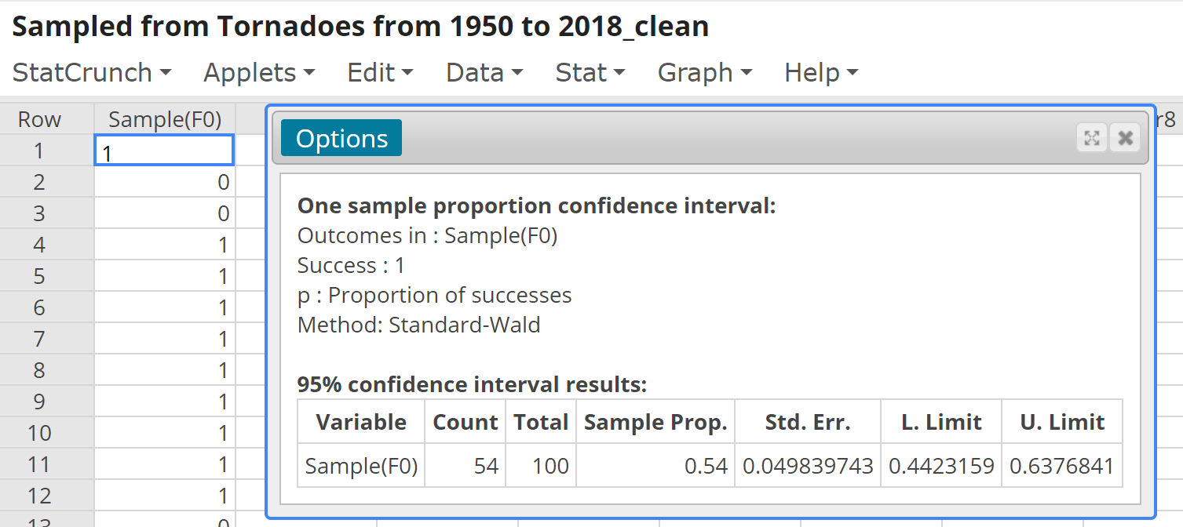
Obtain a Random Sample from the New Variable and Construct a 95% Confidence Interval
Notes:
I recommend having each student obtain their own SRS of n = 100 tornadoes. Ask students to share whether their interval captures the population proportion, 0.468.

Slide 37
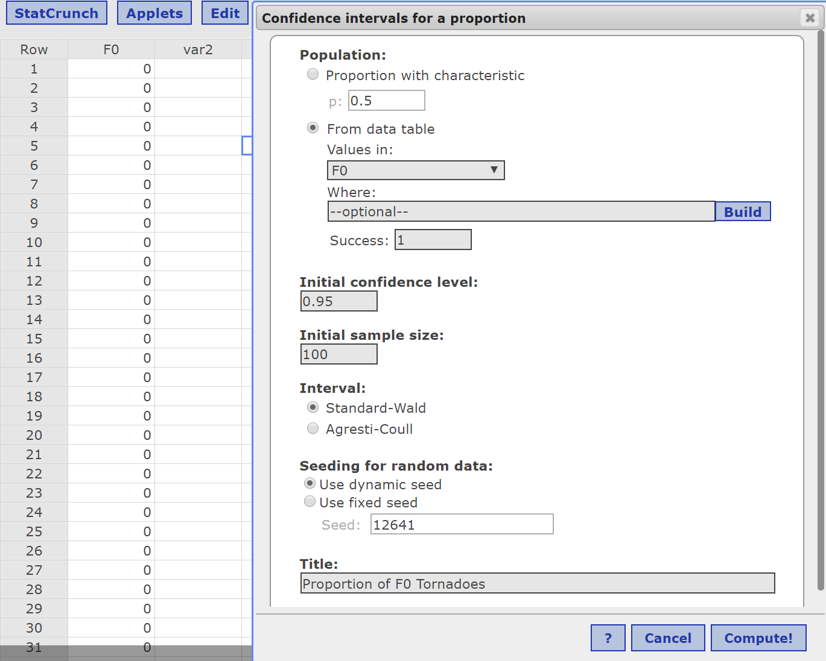
Repeat this Process Many Times (Applet)
Notes:
Use the StatCrunch “Confidence Interval” applet to see the role of level of confidence.

Slide 38
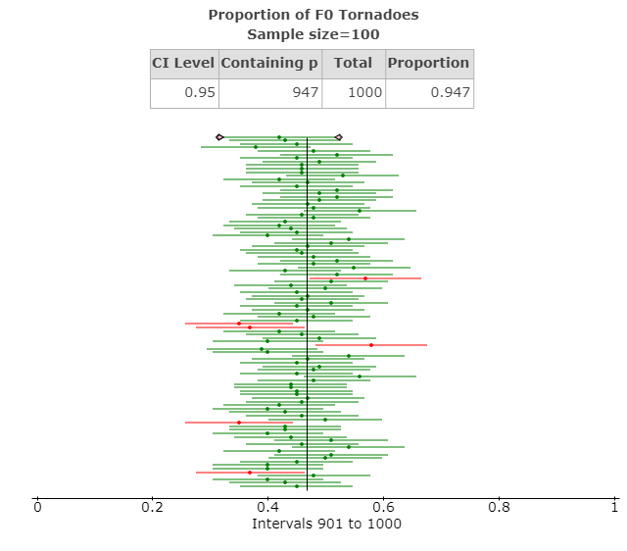
Results

Slide 39
https://sullystats.github.io/Statistics6e/Data/CMC3_2020/Tornadoes_from_1950_to_2018.csv

Slide 40
More Data Sites
www.sullystats.com

Slide 41
Idea for Regression
Zillow
Sample from the tornado data (length and width). Students see that b0 and b1 are statistics.

Slide 42
P-Values
https://my.amatyc.org/viewdocument/what-is-a-p-value

