Slide 1
How To Run a Self-Reflection Classroom (and its Effect on Student Success)
Kevin Shryock December 12, 2020
© 2017 Northern Illinois University

Slide 2
Abstract
Specifically: The effect of self-reflection exercises on student success in Calculus 1
Generally: Plug-and-play classroom framework
Holistic rubric & corresponding self-reflection worksheets
Removing the pressure of performance grades
Results
Significant outperformance
Significantly higher pass rate
Improved understanding of abilities and the content

Slide 3
Overview
Introduction
Design
Research Questions
Results
Summary

Slide 4
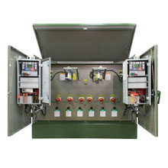
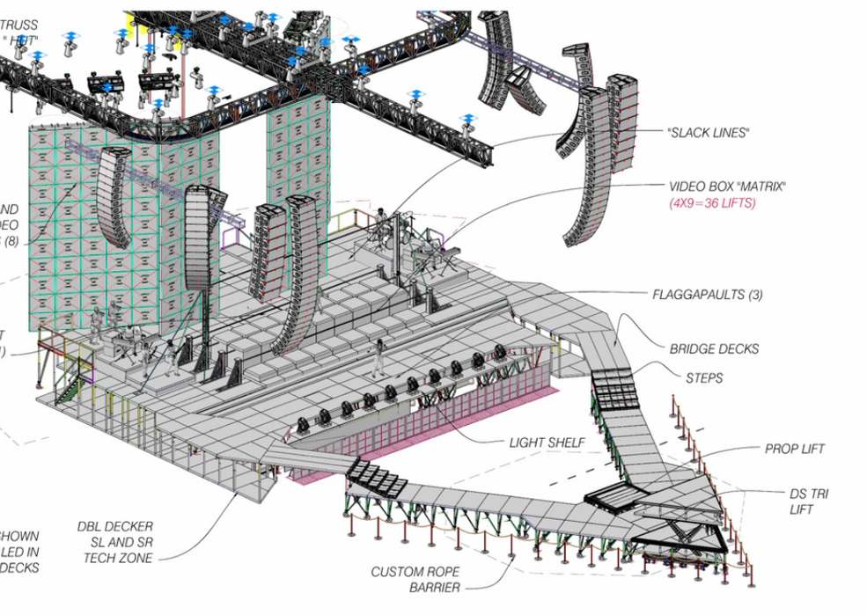
A Little about the Teacher/Researcher
Education
B.S - Industrial Engineering
Masters – Math, Math Ed.
Teaching Experience
NIU- Calc. 3
CLC- Intro. to Mfg.
Industry Experience
Management
Manufacturing/Operations
Quality
Sales

Slide 5
Introduction

Slide 6
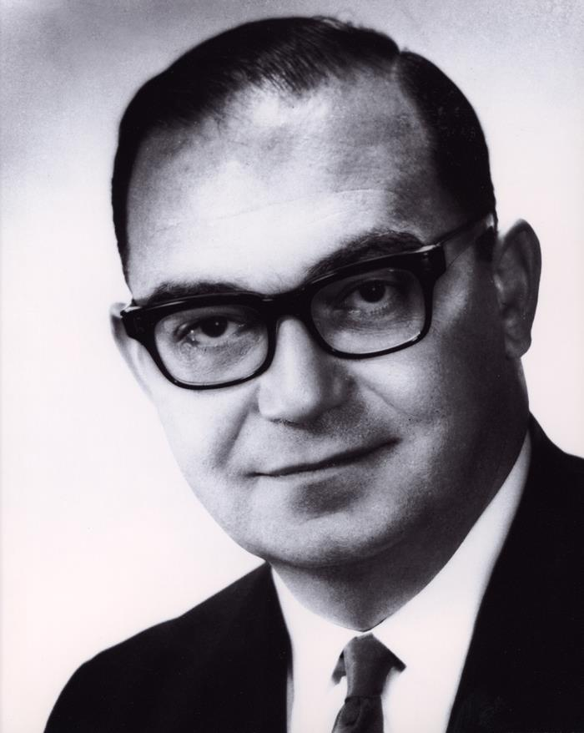
Introduction
1968- Robert White- NAE
Turn Calculus from a “filter to a pump”
2010- MAA
“We seem to have made little progress”
Inside the Classroom
Student-teacher disconnect
Student variety
Student demoralization

Slide 7
Introduction
Is Math Simply Demoralizing?
58% of U.S. adults enjoy math
Most credit the material, not the teaching (Pew Research 2018)
What are the Consequences?
Inadequate supply of STEM talent
The US is “shockingly below” most leading industrialize nations (Hanushek, Peterson, & Woessmann, 2010)
Lost opportunities for students to change their socioeconomical status

Slide 8
Student-Teacher Disconnect
Supply/Demand
Large influx of students
Drastic budget cuts
Direct correlation with future earnings potential
Poor Teaching Practices
“[Only] 34% of faculty reported that they often or very often required students to explain their thinking on assignments“ (MAA)

Slide 9
First Question of the Semester…
What is Math?

Slide 10
First Question of the Semester…
What is Math?
Math is a Model of Logic

Slide 11
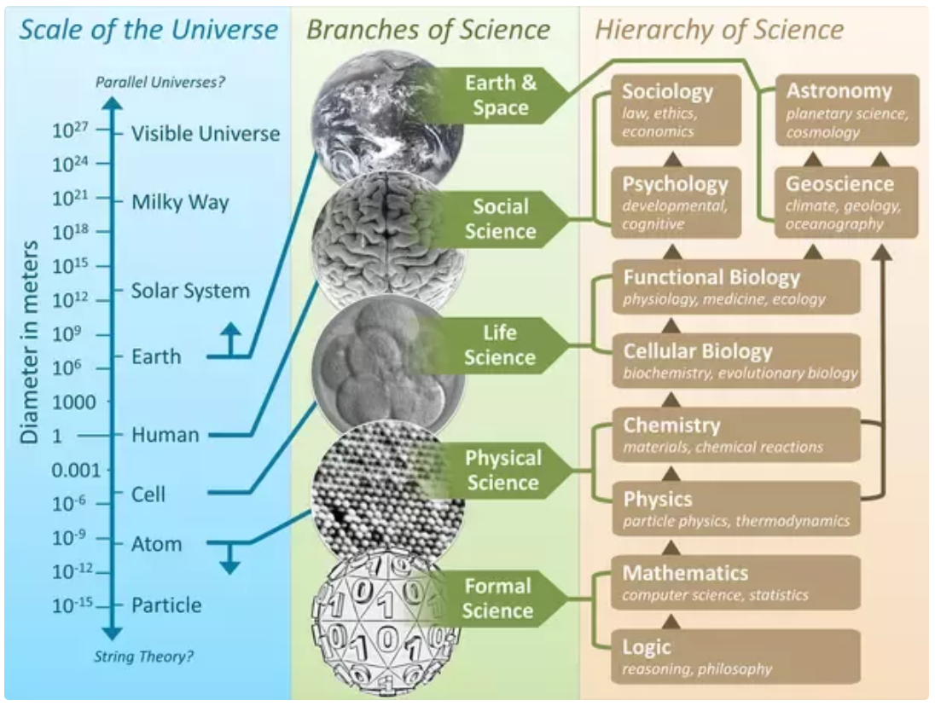

Slide 12
Credit: Flavio Costa, Quora

Slide 13
Credit: Flavio Costa, Quora

Slide 16
Student-Teacher Disconnect
Mixed Messages
Zig-zag of discovery vs. lecture-based instruction

Slide 17
Hidden Figures
Human Computers (mostly segregated women and persons of color) at the NACA and NASA, from the 1930s through the 1980s.

Slide 18
Avoiding the Stigma of “New Math”
Reform courses:
Greater student discontent (until 2 years later)
Technology:
No impact on attitudes (unless done by graduate assistants who averaged negative impact on attitudes)
Group Work, Word Problems, Flipped Reading & Student Explanations of Thinking:
Small negative impacts on student attitudes, confidence, enjoyment and desire to take more math

Slide 19
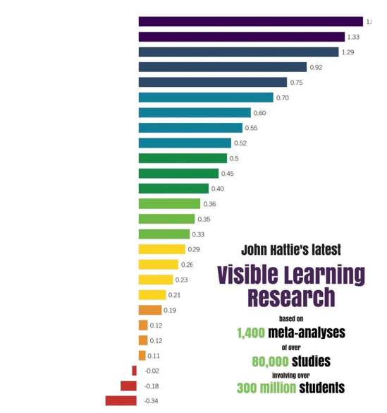
Insights
Self-Report Grades
Student Efficacy
Prior Ability
Teacher Clarity
Learn. Goals
Significance
Homework
Perform. Goals

Slide 20
My Self-Reflection Framework
Goals:
Develop a plug-and-play classroom framework
Duplicate Hattie’s performance findings
Improve student satisfaction
Method: The Self-Reflection Option
Completion/Reflection grades on assignments and quizzes
Performance grades on tests and exams

Slide 21
Building a Self-Reflection Classroom

Slide 22
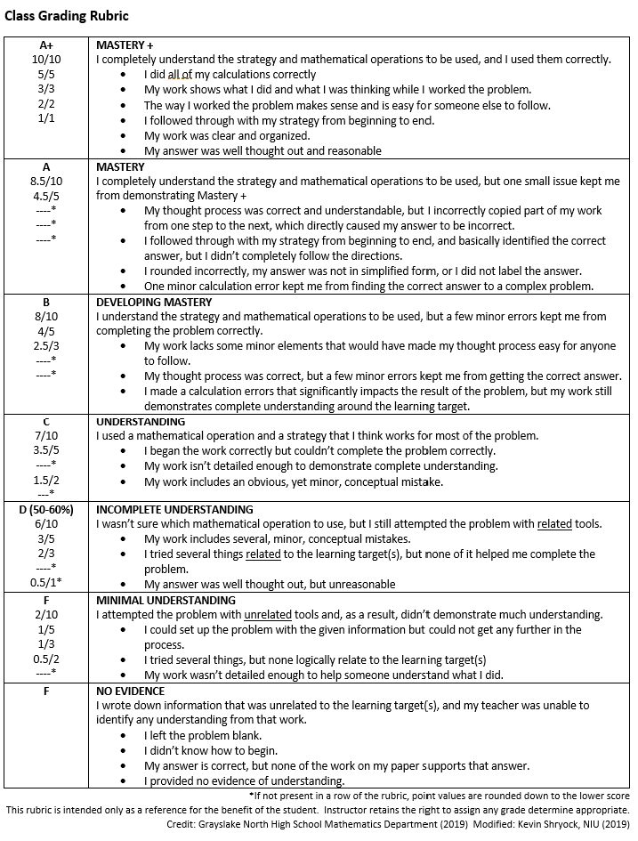
Framework Design
*Credit: Grayslake North High School Math Department

Slide 23
Framework Design
*Credit: Grayslake North High School Math Department

Slide 24
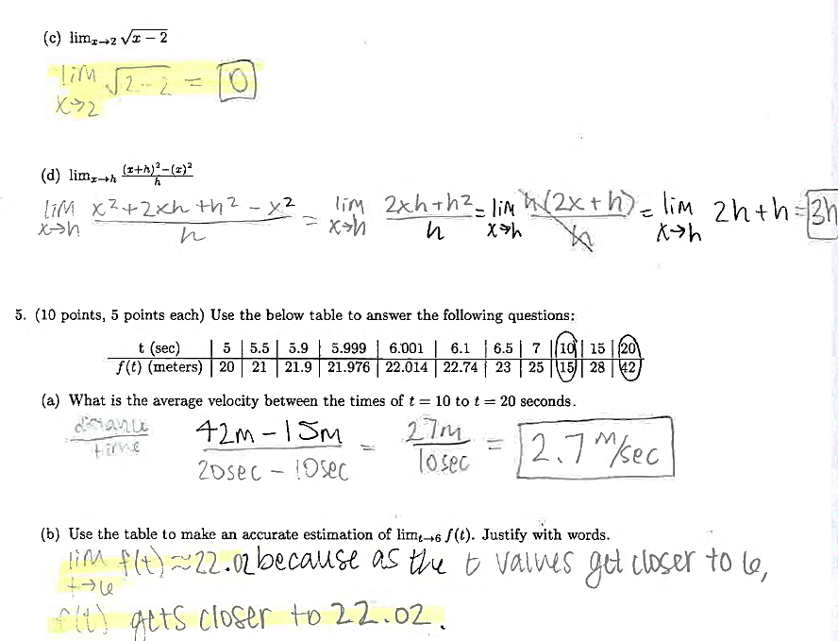
Framework Design

Slide 25
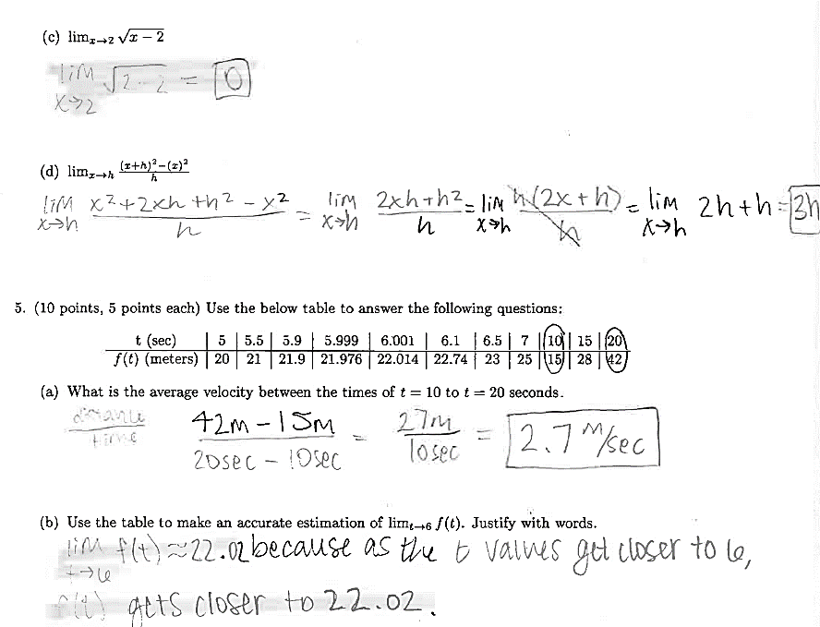
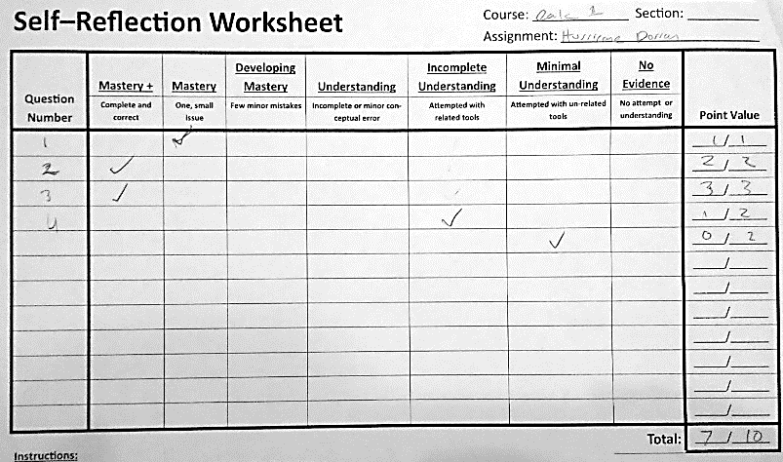
Framework Design

Slide 26
Research Questions
Will students choose the Self-Reflection (SR) option? If so, which?
What is the performance effect?
What is the effect on student’s interest in mathematics?
Do students credit the framework for their success?

Slide 27
Results

Slide 28
Question 1: Student Participation
15/24 students initial opt-in (1 joined later)
= Over 60% initial opt-in
13/15 students retained in the program
= Over 85% retainment

Slide 29
Question 2: Absolute Performance
High
Low

Slide 30
Question 2: Absolute Performance
High
Low
High
Low

Slide 31
Question 2: Absolute Performance
High
Low
High
Low
High
Low

Slide 32
Question 2: Absolute Performance
High
Low
High
Low
High
Low
High
Low

Slide 33
Question 2: Performance Effect

Slide 34
Question 2: Performance Effect
Self-Reflection
No Reflection

Slide 35
Question 3: Effect on Interest

Slide 36
Question 4: Understanding Abilities
Time

Slide 37
Question 4: Understanding Material
Time

Slide 38
Discussion

Slide 39
Summary
Simple plug-and-play
Significant performance improvement
Greater interest in math
Attractive option
Lowered W/F/D rate
Positive impressions
Self-Grading
Student Efficacy
SR Framework

Slide 40
Impact
Theory
Ample grades demoralize and distract
Teaching Practice
Bridged student-teacher disconnect
Handled variety of students
Motivated student interest

Slide 41
Reflection in The Virtual Classroom
Online submissions via student photos
Answer key made available automatically
Solution video walkthroughs
Automatic credit (with review)
Decreased paper shuffling
Focused class time

Slide 42
Conclusion
1968- Robert White
Turn Calculus from a “filter to a pump”
2015- MAA
“We seem to have made little progress”
2020- CMC3
Learning, not performing, is the key to success in math education

Slide 43
Keep in Touch!
Email: Kevin.shryock@gmail.com
Linkedin: Kevin Shryock
Youtube: Beyond Lecture

