Slide 1
Top Hat ~ CMC3 202
The Power of the Ask
DONNA M. SMITH
MICROWAVES, PEAKS, VALLEYS & A DECK OF CARDS
Engaged LEARNING in a Virtual Era
Notes:
I would like to thank you for taking time out of your busy schedules to allow me to share about Microwaves, Peaks, Valleys and a Deck of Cards I would like to thank Jay for the introduction and Traci as well, they will be helping to manage the chat

Slide 2
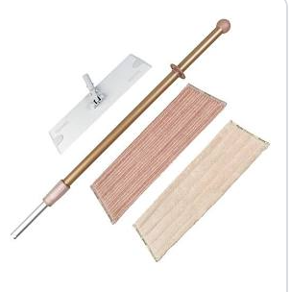
Top Hat ~ CMC3 202
The Power of the Ask
Norwex
Mop Story
Who starts using a new platform in the middle of a pandemic?
Notes:
Why would you transfer all 30 pages of your content from Canvas for your Statistics class in the middle of a pandemic? Let me share my mop story. When I moved from Sacramento to Lincoln almost four years ago, closer to Sierra College where I teach, I met a wonderful friend Chris. She helped me stage my home so I could sell to move to Lincoln. I asked her to help me with my new home so that it would like as nice as the one that was staged. In helping me get prepared for a house warming party, I noticed when Chris cleaned my kitchen floors they felt amazing. She explained that she vacuums the tile floors first, then she mops the floors and then she sweeps the floors. As much as I loved the feel of my kitchen floors, I resolved I just would have "Chris - clean" floors. When my i-robot mop broke for the second time, I purchased a Norwex mop/broom. This is a disclaimer, I am not a Norwex distributor and I am not compensated - just sharing as a love story. I had spilled something on the floor and used the mop to clean one section, but quickly realized that was quick, let me cover this section near the stove, hmm might as well do the butler's pantry. Before I knew it I had mopped the kitchen and the eat in dining area. The floor had dried because of the super absorbent microfibers and you only use water. I had the thought - "Chris clean" floors. I switched the attachment and swept. The time it would have take to mop that small portion of the floor I was able to "Chris clean" my complete kitchen floor. In the time it would take to create one quiz on Canvas - I could do so much more with Top Hat. So let's begin

Slide 3
Top Hat ~ CMC3 202
The Power of the Ask
01 Top Hat Poll
TODAY'S AGENDA

Slide 4
Top Hat ~ CMC3 202
The Power of the Ask
01 Top Hat Poll
02 Microwaves in Trignometry
TODAY'S AGENDA

Slide 5
Top Hat ~ CMC3 2020
The Power of the Ask
01 Top Hat Poll
02 Microwaves in Trignometry
TODAY'S AGENDA
03 Five of My Favorite Things

Slide 6
Top Hat ~ CMC3 2020
The Power of the Ask
01 Top Hat Poll
02 Microwaves in Trignometry
TODAY'S AGENDA
03 Five of My Favorite Things
04 Peaks, Valleys, & Cards

Slide 7
Top Hat ~ CMC3 2020
The Power of the Ask
01 Top Hat Poll
02 Microwaves in Trignometry
TODAY'S AGENDA
03 Five of My Favorite Things
04 Peaks, Valleys, & Cards
05 Questions & Comments

Slide 8
Top Hat ~ CMC3 2020
The Power of the Ask
FIRST ROUND
PART 01 - TOP HAT POLL
Notes:
If you are concerned about losing your zoom window which has the directions, it would be best to take the poll on your phone or on a tablet.
If you have any questions navigating screens to take the poll, use the chat and our tech host will help you.

Slide 9
Top Hat ~ CMC3 2020
The Power of the Ask
Website
TOPHAT.COM
CHROME
MOZILLA FIREFOX

Slide 10
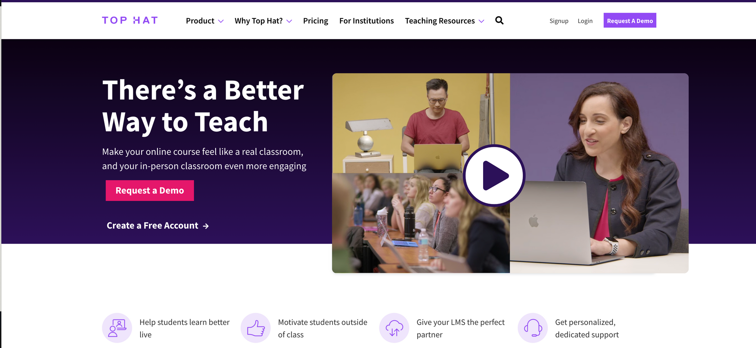
Top Hat ~ CMC3 2020
The Power of the Ask
Notes:
It is extremely important that you do not skip ahead because you can easily miss the "7- Day trial option". For those of you who are Top Hat users, you will only need the join code - it's coming

Slide 11
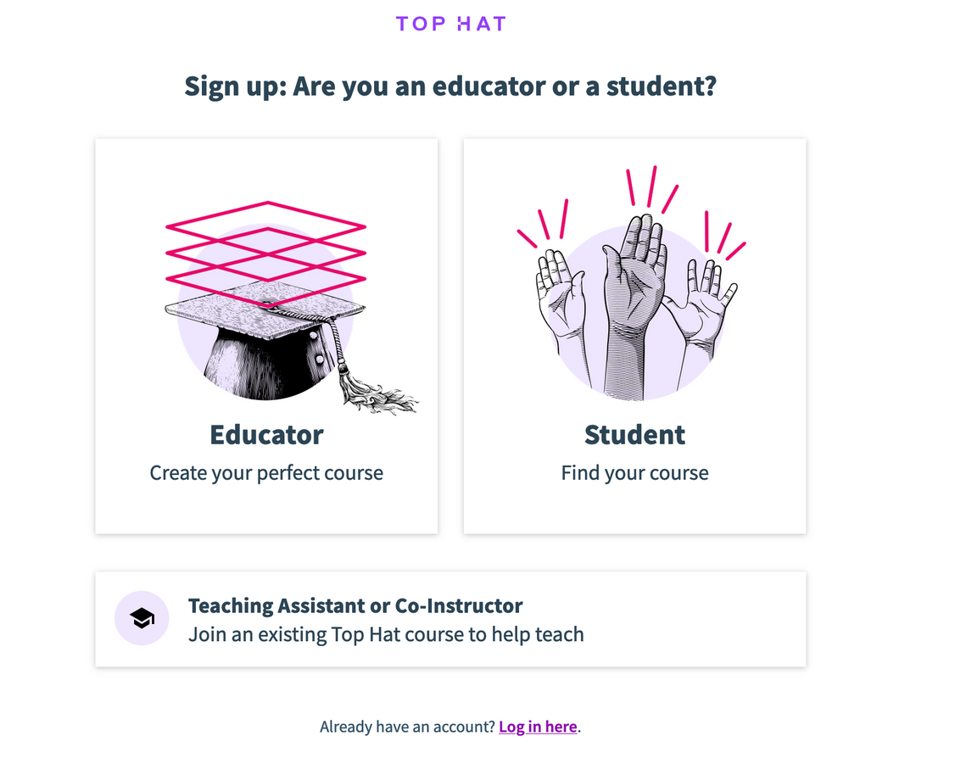
Top Hat ~ CMC3 2020
The Power of the Ask
Notes:
You will next the Student Option

Slide 12
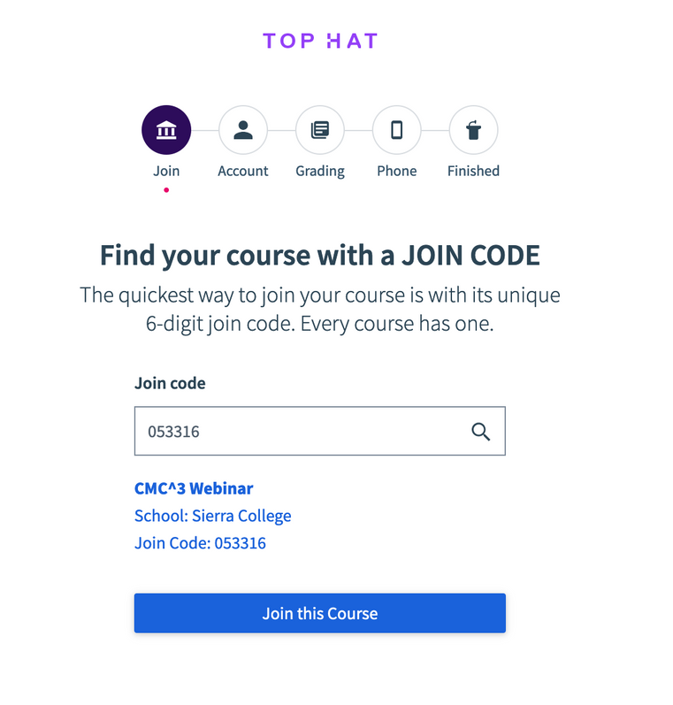
Top Hat ~ CMC3 202
The Power of the Ask
JOIN CODE:
053316

Slide 13
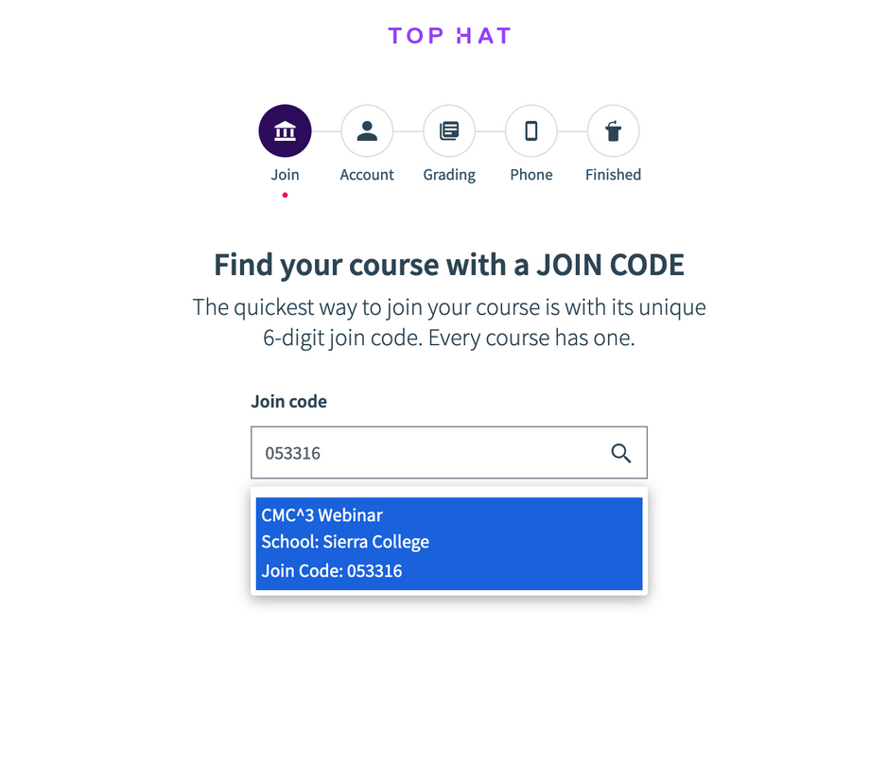
Top Hat ~ CMC3 202
The Power of the Ask
CONFIRM

Slide 14
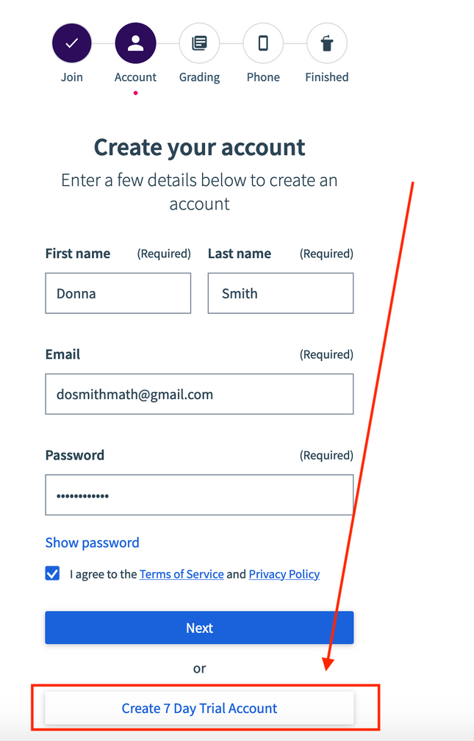
Top Hat ~ CMC3 202
The Power of the Ask
IMPORTANT
PLEASE SELECT 7 DAY TRIAL
DO NOT SELECT NEXT
You can use "Student" for last name
Faculty account
dosmith+1@sierracollege.edu
Notes:
Enter your first name last name, college email, for your last name I would use Student and then select 7 day trial.

Slide 15
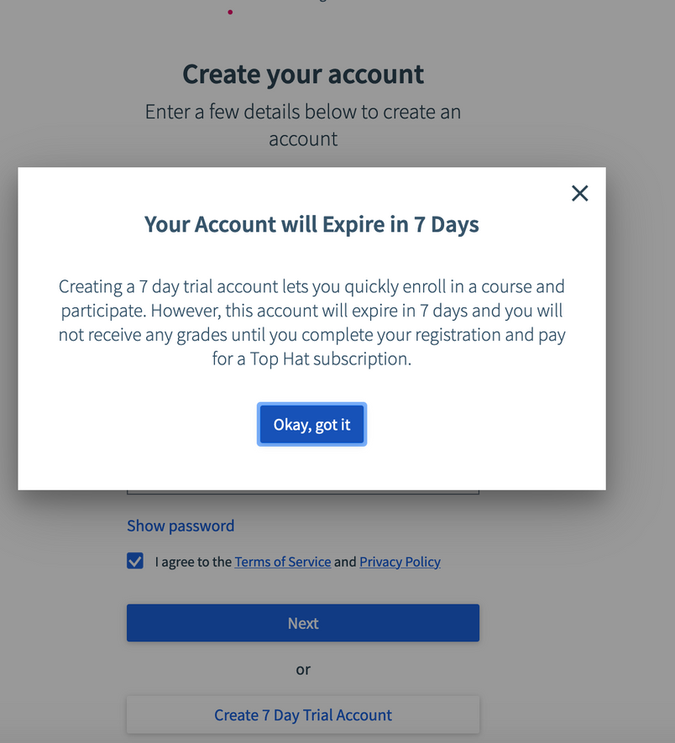
Top Hat ~ CMC3 202
The Power of the Ask
ACCOUNT EXPIRATION
Notes:
Now I am going to mirror my phone so we can step through the process together.

Slide 16
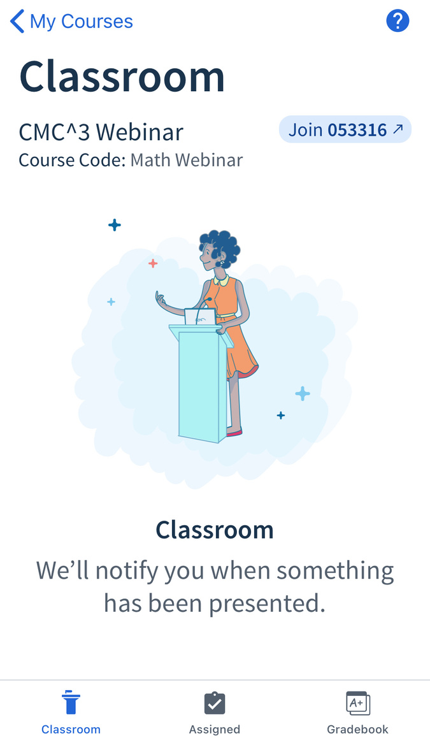
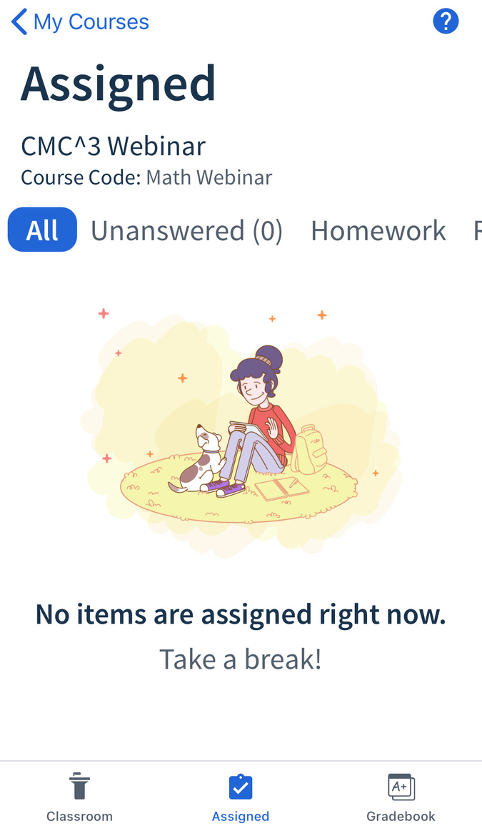
POLL TIME
Top Hat ~ CMC3 202
The Power of the Ask
Notes:
This is an image from my iphone

Slide 17
Top Hat ~ CMC3 2020
The Power of the Ask
SECOND ROUND
PART 02 - MICROWAVE

Slide 18
Microwave Ovens in Trigonometry
Top Hat ~ CMC3 2020
The Power of the Ask
Notes:
Now let's watch a snippet of the Microwave video that is featured in my Trig class with Top Hat which we will visit after the video.
(Week 11 Group C)
https://app.tophat.com/e/042863/page/245046648

Slide 19
Top Hat ~ CMC3 2020
The Power of the Ask
THIRD ROUND
PART 03 - FIVE OF MY FAVORITE
THINGS

Slide 20
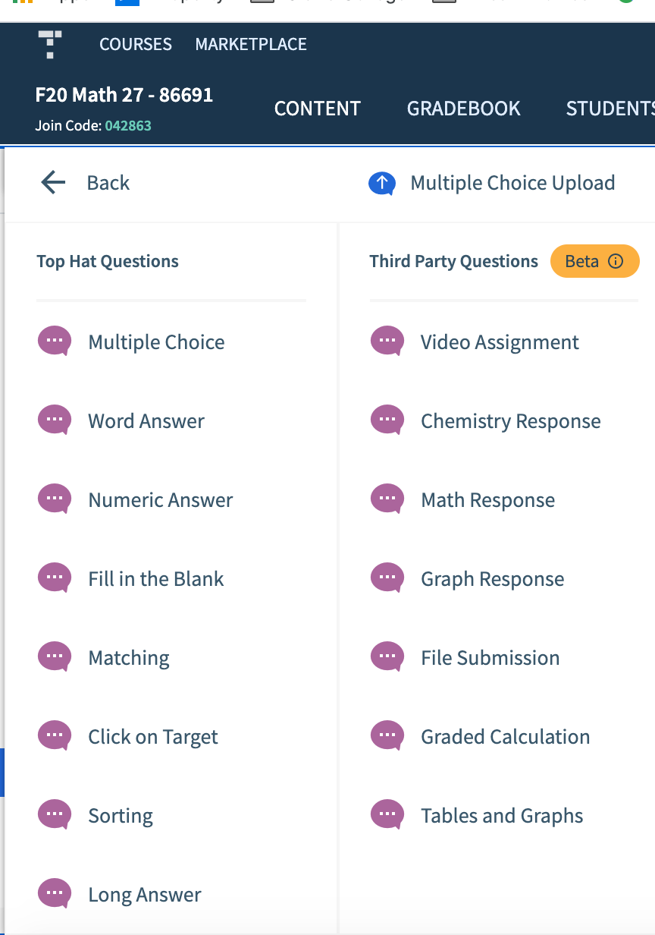
1 ~ Question Types
I use 9 on a regular basis, 10 if you include discussion "questions"
Notes:
I use 9 on a regular basis and with the discussion question that makes ten.

Slide 21
QUESTION TYPES
8 Question Types in Microwave Assignment
01 Multiple Choice
02 Word Answer
03 Numeric Answer
04 Fill in the Blank
05 Long Answer
06 File Submission
07 Graded Calculation
08 Discussion
Notes:
We used 8 question types in the Microwave Assignment

Slide 22
2 ~Ease of Grading

Slide 24
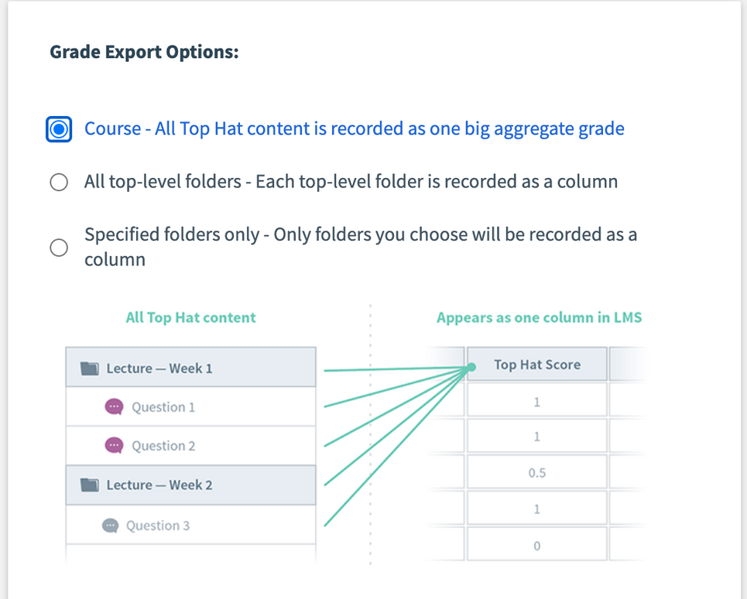
Top Hat ~ CMC3 2020
The Power of the Ask
3. Syncing with Canvas
Notes:
You can sync the grades as an aggregate grade or by specified folders. This semester I used one Top Hat grade.

Slide 25
4 ~ Course
design
Ease of Creating/Uploading Content with Pages, Folders, etc.
Top Hat Instructional Designer
Notes:
My next favorite thing is #4 - Course Design. Content is easy to create and upload with pages ad folders and you also have an Top Hat Instructional Designer

Slide 26
5 ~ Virtual Classroom
Notes:
Let's go out to Top Hat to take a glance at #5 the Virtual Classroom.
Math 13 with Support.

Slide 27
Top Hat ~ CMC3 2020
The Power of the Ask
FOURTH ROUND
PART 04 - PEAKS & VALLEYS

Slide 28
Thank you!
Donna M. Smith
dosmith@sierracollege.edu
Faculty Account on Top Hat
dosmith+1@sierracollege.edu
Top Hat ~ CMC3 2020
The Power of the Ask
Notes:
Jay Leholm, Tracy CMC^3 Board and my dear friend James Sullivan

Slide 29
Goulcrest Learning Center
FIFTH ROUND
PART 05 - QUESTIONS & ANSWERS

