Slide 1
Please wait

Slide 2
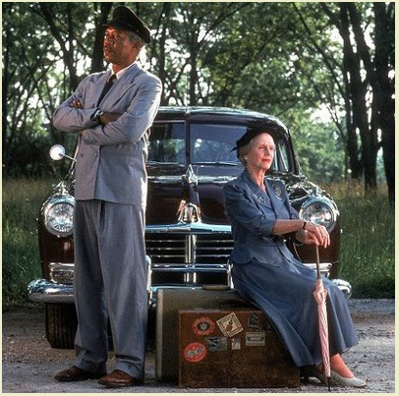
Driving Miss GAISE

Slide 3
Why the title?
        • Daisy rhymes with “GAISE”
        • 2004 report :
        “Guidelines for Assessment and Instruction in Statistics Education” – hence GAISE
        • Design of the Introductory Course,
        • Found at:
        http://www.amstat.org/Education/gaise/GAISECollege.htm

Slide 4
Driving Miss GAISE . . .
        • Operative word is “Driving”:
        – Conveys our experience following the GAISE recommendations
        – Share the adventure, see what colleagues think . . .
        • GAISE more for text writers than for instructors?

Slide 5
GAISE, for us. . .
        • Constraints
        – text choice
        – technology available,
        – what one is expected to “cover”
        – transferability concerns
        • Premise: we are not locked in
        • How the present project started
        • And developed

Slide 6
Goals for the presentation. . .
        • Share what we have done – “Driving GAISE”
        • Get feedback from colleagues who face similar challenges – wanting to teach a course along these lines
Procedure
        • Relate our experience to the six GAISE recommendations
        • After reorganizing the recommendations . . .

Slide 7
Recommendations, reorganized
        4. Foster active learning in the classroom;
        2. Use real data;
        Most transparent and clear?
        5. Use technology for developing conceptual understanding and analyzing data;
        6. Use assessments to improve and evaluate student learning;
        Raise more questions?
        1. Emphasize statistical literacy and develop statistical thinking;
        3. Stress conceptual understanding rather than mere knowledge of procedures;
        Look like goals . . .

Slide 8
Firing Order: 4, 2, 5, 6, 1, 3
        4. Foster active learning in the classroom;
The core of our answer are guided inquiry exercises.
• What are they?
• How do we use them?
• See any of the “Exhibits”

Slide 9
Guided Inquiry Exercises: What are they?
• Sequence of questions,
– hopefully in logical order,
– hopefully leading to an understanding of the material,
– addressing difficulties that students have.
• Not a new or novel idea:
– Chakerian, Stein and Crabill, Geometry
– Rossman/Chance’s Workshop Statistics.
– Also: CMC³ presentations

Slide 10
Guided Inquiries: Short Example

Slide 11
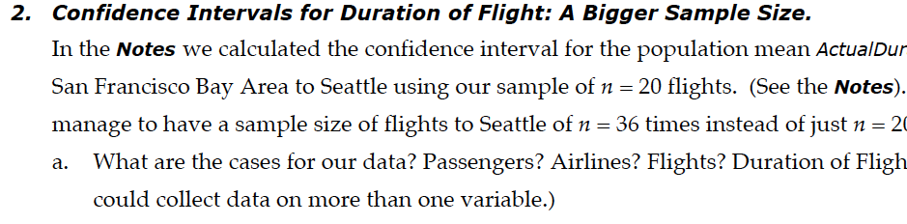
Guided Inquiries: Short Example
• Confidence interval for one mean
• Follows “text” example
• First question: what are we dealing with?

Slide 12
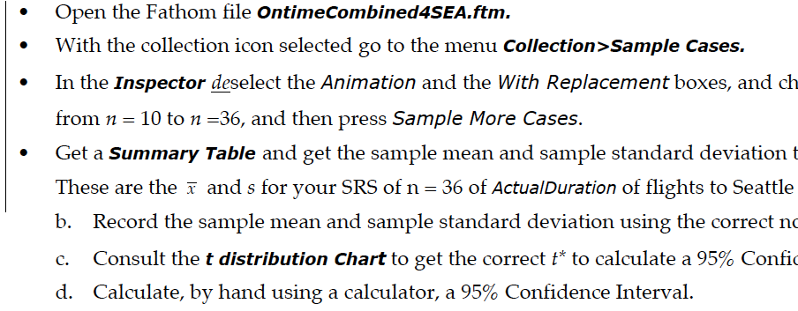
Guided Inquiries: Short Example
• Each team has their own sample, from a large sample
• Instructions to get the sample
• Decisions: Practice by hand – why?

Slide 13
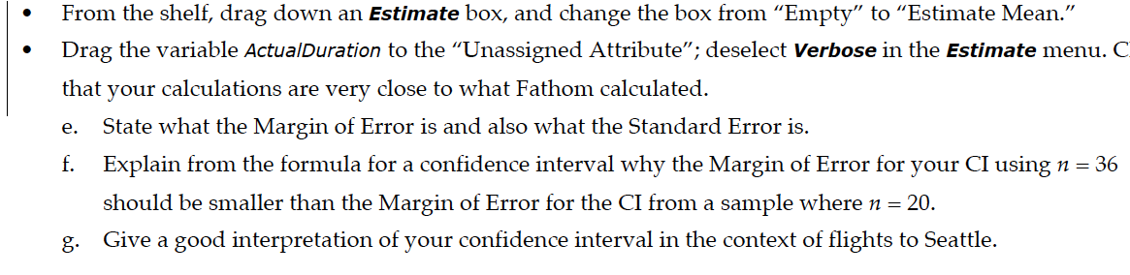
Guided Inquiries: Short Example
• Can check the calculations
• How the formula works: effect of a bigger sample size
• Give a good interpretation, in context
• Could go farther: how many CI include 119 minutes

Slide 14
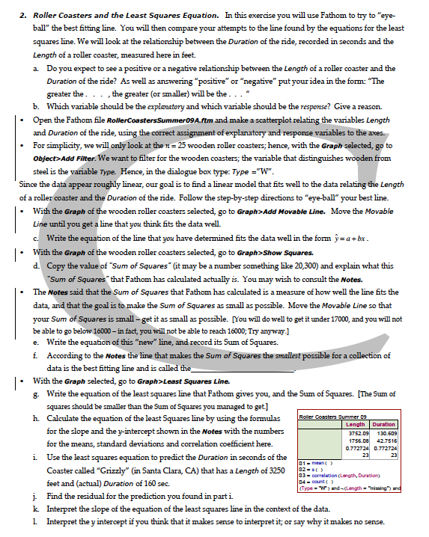
Guided Inquiries: Experience
• Use the same data set for one Exercise, with typically one or two statistical questions in mind about those data.
• Want to emphasize what the outcomes mean, as well as the techniques, so limiting the context is deliberate.
• Also use technology so hand calculations and graphics made by hand can be checked naturally without looking at an “answer key.”
• How do we use these? We have a classroom.

Slide 15
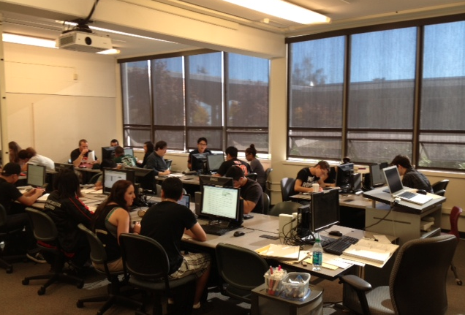
How we use guided inquiries:
We have this room

Slide 16
Our home for guided inquiries:
• Computers
• → ← equipment for projecting
• Arrangement of the room
• Meet in two-hour blocks of time twice a week
• Procedure

Slide 17
How it works:
• Really is active . . .
• Groups that interact benefit from the interaction:
– Students social beings
– Easily answered questions
– Bigger questions
• Instructor freed up to help

Slide 18
Problems?
• Keeping to task?
• Loners?
• Freeloaders?
• Problems not insurmountable. . . up to the instructor
        • Five instructors, each with one or two sections,

Slide 19
The Place of Lectures
• Why lectures at all?
– Tradition: students and instructors believe that teaching = lecturing
• Very complex situation
– Student tendency to depend on lectures?
– Little reading of the text?
– Some of stats is: “Do this problem like this” – but much is conceptual
– Lectures for “pep talks”, integrating, problems
• Or perhaps much shorter ones? Or “flipped?”

Slide 20
Guided Inquiries Summary
• Convinced that Guided Inquiries make good use of class time
• But another important reason for using them:
They are enjoyable to make!

Slide 21
Firing on 2:
        2. Use real data
• What does it mean to use real data?
• What does it mean to not use real data?
• GAISE Report reacting to:
• But why use real data? Why not simulated data? Or pretend data? Does it really matter?
Concocted data without context
Pretend data: “Suppose . . . “

Slide 22
Using Real Data: Why or why not?
• Why use real data?
– It is what we do: analyze data
– Interest to students
– Shows what statistics is for
– Expand student horizons
– Not just going through hoops . . .
– Real data are messy
• Why not use real data?
– Real data are too messy
– Who can tell real data from simulated data?
– Real data are too hard to find
– Real data do not make the points we want to make

Slide 23
Using Real Data: A Policy
• Our rule: the data are real or are “fantastic”
– “Fantastic” in the sense of sense fanciful or imaginative
– Example: “Exhibit H” about Hobbits and Men in the town of Bree
– Important that “made up” data should be clearly identified as made up

Slide 24
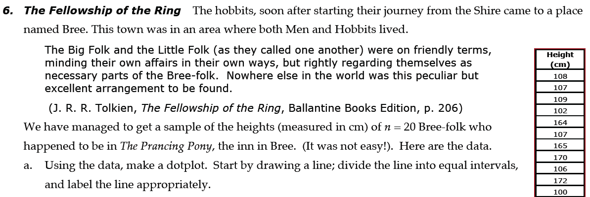
Using Fanciful Data: Example
• Exercise for hand work:
– Calculation of mean and median, and five number summary
– Lesson that graphics reveal and obscure data features . . .
• But what about real data? Where from?

Slide 25
Snagging real data
• Snag: transitive verb: to obtain something by luck or skillful maneuvering
• Search everywhere
– Depositories of data sets
UCLA, UC Irvine, CAUSE
– Think big: Even > 10,000 cases, so that you have enough to take samples
Examples: CDC Birth data, NHANES, baseball data, Airline flight data
–Look for “databases”

Slide 26
Snagging real data: Lessons from Experience
• Data bases are not meant for statistical analysis
Examples: Roller Coaster data base, beer rater, movie data base, hiking trails, gadgets, . . .
• Expect work with databases. . .
• Mix of categorical and quantitative – “rich data“ with many variables.
• Real data need cleansing:
Examples: Census @ School from Australia or New Zealand

Slide 27
Snagging real data: More
• Collecting data from students
• Collecting data with students
• Something new: Generate data from games, as:
http://web.grinnell.edu/individuals/kuipers/stat2labs/Labs.html
• “Real data” is also data already analyzed:
– Exhibit on a weight loss experiment
– Melbourne study on drivers’ mobile phone usage
• One of my favorites . . .

Slide 28
Real papers
But, what data?

Slide 29
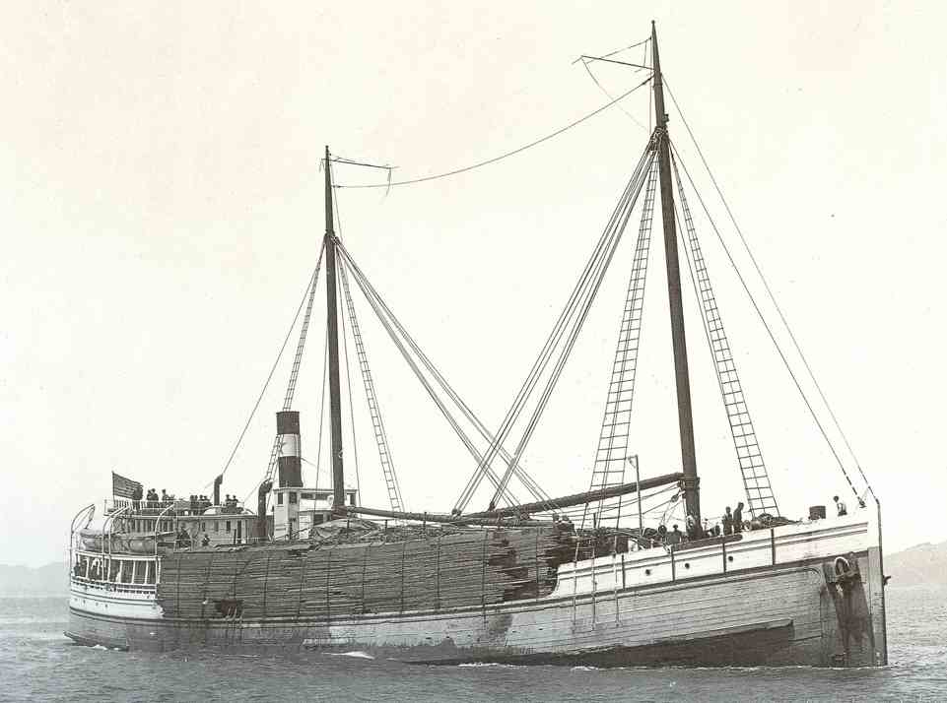
Which data?: The saga of the steam schooners
• GAISE Recommendation expanded:
Make sure questions used with data sets are of interest to students –– if no one cares about the questions, it’s not a good data set for the introductory class.
(Example: physical measurements on species no one has heard of.)
• Ouch!

Slide 30
Who here has heard of steam schooners?

Slide 31
Who here has heard of steam schooners?
• Wooden “schooners” important in the coastal trade in California from about 1875 – 1935
(Note the load of lumber)
• Form the basis of one of our guided inquiries – and it seems to work.

Slide 32
Guilty, and plea for mercy
• Interest and connectedness to student’s lives is important, . . .
• Expanding horizons is also good
– Number of people in a household: the idea is easy for students, . . .
– Allows comparison with data on household size in other times and places also important.
• Still, we plead guilty, and need people to make guided inquiries on e.g., baseball, music, movies
Snagging data, both for analysis and from already published papers, is great fun!

Slide 33
Technology (GAISE Cylinder 5)
        • Use technology for developing conceptual understanding and analyzing data
        • Which technology?
        – Computers, not calculators
        – Decided to Use Fathom, from Key Press . . .
        • We use Fathom both for data analysis and also for developing conceptual understanding.
        • Students are required to have a copy; but it is cheap ($10)
        • Best to see some examples:
        – Regression Example
        – Sampling Distribution Example

Slide 34
Technology
        TI: 23/33 70%
        Excel: 9/33 27%
        StatCrunch: 8/33 24%
        Wait, please

Slide 35
Technology Questions and Issues
        • Simulation: what is its place?
        – At USCOTS and at JSM, much discussion of simulation: See www.lock5stat.com
        – Important that students see what is happening
        – Hands on “simulation” first
        – Does it solve the conceptual problems?
        No, but it helps
        • An improvement towards understanding p-value but must emphasize what tail probabilities mean.
        •

Slide 36
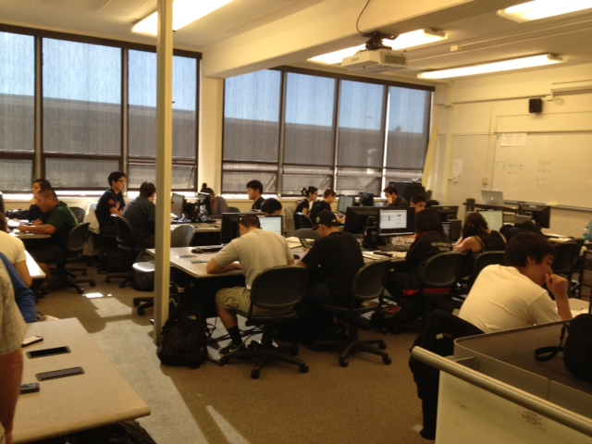
Technology Questions and Issues
        • Software other than Fathom?
        – with Minitab, JMP, StatCrunch . . .
        – with Excel, possibly . . .
        – with R ? Free, and useful to learn, but have to over come the command interface barrier.
        • The near future: materials on tablets or lap-tops, so that a computer equipped room is not as necessary
        • But advice: get a room with tables, not chairs
        •

Slide 37
Assessment (GAISE 6)
        • Use assessments to improve and evaluate student learning
        • What does this mean? One of the least specific parts of GAISE
• But do say: Use projects of some sort
• What kind of project, and how?
– Experience at the JSM Roundtable
– Procedure:
Describe what we have come up with (See B)
Why it is it worthwhile
Challenges

Slide 38
Writing Assignment

Slide 39
Writing Assignment
• Use the data we have collected
• Statistical questions are defined
• Definition of the project is:
– analyze the data, and
– write about what the data say in terms that someone who has not had a course in statistics will understand
• Multiple deadlines: one of the most useful is the “Rough Draft” stage, where instructor makes comments
• There is an example essay (on a different topic)

Slide 40
Our Experience
• The WA is limited to the descriptive part of the course
– Time constraints on the instructor’s part
– Challenging enough
– Much of the data we have does not employ randomization
• Try to have a group project – to cut down on the amount of work
• Common tendency:
– Parrot back what has been learnt in the course
– Telling, shows why we need something like the writing assignment

Slide 41
Our Experience, continued
• Issues of logic and critical thinking
How does the age of a mother who has a child influence the extent of her education? . . . It seems that women who have graduated from high school or are under this age begin having children earlier. . . than those who went to college.

Slide 42
Our Experience, continued
• Labor intensive for instructors, even with streamlining
• Timed assessments are efficient for testing
– specific facts or understandings
– skills,
– but for critical thinking, or for
– interpretation
• Now, true that students who do well on tests tend also to do well on the WA, but there are exceptions
• Basing the WA on our data
– means that we can change the assignments, or use samples (as a bulwark against plagiarism)
– but also open to student analyzing other data

Slide 43
Assessment, dieseling . .
• Try to make tests “themed” so that all of the analysis and interpretations are about the same data
• Often, begun with one of the hardest questions:
“What are the cases?” (observational units)
• Mixture of “How did they calculate that”, facts and interpretation
• On to the last two cylinders . . .

Slide 44
        Emphasize statistical literacy and develop statistical thinking
        Stress conceptual understanding rather than mere knowledge of procedures
• Are we attaining these goals?
• Objective sense: no objective data
– No pre- and post-test data
– No retention or “success” data (in two senses)
– Such data may be problematic, in that Driving Miss GAISE may make the course more difficult
– Most of our objective measures may be far too crude: we should measure three years or more hence.

Slide 45
        Emphasize statistical literacy and develop statistical thinking
        Stress conceptual understanding rather than mere knowledge of procedures
• Subjective sense: mixed
– Course still too full of formulas
– Driving Miss GAISE, seeing misunderstandings makes one aware of how big the task is
– How far statistical thinking is from most students’ experience
– How satisfying seeing thinking develop. . .

Slide 46
        Conclusion
Are we satisfied with the drive?
Of course not
But, overall, it is a good drive
[OK: Make, model and year . . .?]
Contact Info: brownkm@smccd.edu

