Slide 1
Famous Mathematicians I have Interviewed
Anthony Barcellos
American River College
CMC³
December 2012
Notes:
This unfortunate title has a couple of significant problems with it. When I suggested it to Mark Harbison as a placeholder, I expected to follow up with something better. First of all, not all of the people I interviewed would agree to being described as a “mathematician.” Second, it doesn’t sound like a very interesting talk.

Slide 2
Three Interviews
Notes:
My interviews were with Stan Ulam, Martin Gardner, and Benoit Mandelbrot and all three ended up as cover stories for the Two-Year College Math Journal (later renamed the College Math Journal).

Slide 3
Three Guys talk about Math
Anthony Barcellos
American River College
CMC³
December 2012
Notes:
This is a more accurate title, but it’s still pretty boring, so …

Slide 4
My Near-Great Life
Anthony Barcellos
American River College
CMC³
December 2012
Notes:
Here’s a better title! It’s not that my life is “near-great.” It’s that over the years I have been privileged to frequent the company of several great men. I have thus been “near greatness.”

Slide 5
Henry Alder
Notes:
Certainly Henry Alder belongs near the top of my list. Henry chose me for his teaching assistant when I was a new graduate student at UC Davis. I attended his calculus lectures and graded his exams. (I graded the first exam twice. Henry had exacting standards and I learned a lot living up to them.)

Slide 6
Sherman Stein
Notes:
I was also Sherman Stein’s TA. He came to my attention when I was still in junior college in Porterville and I saw a W. H. Freeman advertisement in Scientific American for Stein’s Mathematics: The Man-made Universe. I quickly ordered a copy. I routinely read Scientific American to follow Martin Gardner’s “Mathematical Games” column.

Slide 7
Tom Sallee
Notes:
At UC Davis I fell into the clutches of Tom Sallee. When I took his geometry class, I had to write a term paper. I chose a nice title.

Slide 8
Geometry term paper
The relationship of non-Euclidean geometry to the universe and everything in it
Notes:
My title was a bit hyperbolic: “The relationship of non-Euclidean geometry to the universe and everything in it.”

Slide 9
Geometry term paper
The relationship of non-Euclidean geometry to the universe and everything in it
“Seems a little broad”
Notes:
Tom loved it, although he wrote me a marginal note: “Seems a little broad.” When Henry Alder encouraged me to apply for a Mass Media Fellowship with the American Association for the Advancement of Science, Tom wrote me an excellent recommendation and helped me win the fellowship.

Slide 10
AAAS Mass Media Fellowship Program
Notes:
Thanks to Henry and Tom, I got to spend the summer of 1978 as a AAAS-sponsored science writer on the staff of the Albuquerque Journal. It is difficult to overstate the importance of this experience in shaping my life as a writer and math teacher.

Slide 11
Notes:
The biggest of my articles for the Albuquerque Journal ran on the front page, heralding the operational status of the new Very Large Array radio telescope in the desert outside Socorro, New Mexico. My students get to see this photo of a parabolic dish antenna whenever we get to the unit on conic sections (and why it matters where the focus is).

Slide 12
James Nachtwey
Notes:
The photographer on the VLA story was Jim Natchtwey, who has since gone on to fame as a photo-journalist who fearlessly documents the world’s trouble spots, including wars and natural disasters. He is one more example of my good fortune in encountering great people.

Slide 13
The Senate Fellowship Program
Notes:
The Mass Media Fellowship led directly the following year to my acceptance into the California State Senate Fellowship program. The members of the screening panel may have been skeptical about selecting a mathematician for a legislative position, but they were impressed by my time as a science journalist. Of course, it was my strong math background as well as tutelage by articulate math educators that made it all possible.

Slide 14
Albert Rodda
Notes:
I was assigned to the office of Sen. Albert S. Rodda, the senior member of the State Senate. Rodda was chair of the Senate Finance Committee and was probably best known for his sponsorship of SB 160, the measure that secured collective bargaining rights for public-sector teachers. The Senator was also a former community college professor, having been on the faculty of Sacramento City College, where a building complex is named in his honor. He held a Ph.D. from Stanford. Working for Rodda gave me experience in legislation, constituent services, and the state budget process. He also let me work on his successful campaign against Howard Jarvis’s Proposition 9 (June 1980).

Slide 15
Jesse Unruh
Notes:
I stayed on Sen. Rodda’s staff when he accepted an offer from State Treasurer Jess Unruh to serve as executive officer of the Commission on State Finance. I tracked legislation (since I had legislative staff experience), edited Commission reports (since I had professional writing experience), and provided some computer support services (since I was a nerd who was active in the Sacramento IBM PC Users Group).

Slide 16
Office Building 1 (Jesse M. Unruh State Office Building)
Notes:
The Commission on State Finance was housed in State Office Building 1 (yes, I’ve heard all the jokes about the initials), since named the Jesse M. Unruh Building. It is opposite the State Capitol.

Slide 17
“Hello. I’m from the state and I’m here to help you.”
Notes:
My business cards as a state worker.

Slide 18
Pat Brown
Notes:
I got to meet former governor Edmund G. “Pat” Brown, Sr., and shake his hand, which means I’ve shaken hands with a man who shook hands with John F. Kennedy – and no doubt Richard Nixon, too, but I don’t talk about that.

Slide 19
Anastasio Somoza
Notes:
In fact, I even got to shake hands with a Latin American tyrant, Anastasio Somoza, dictator of Nicaragua. I met him during his visit to Sandia Labs in Albuquerque, where I was part of the press contingent. Let’s not think too much about where his hands had been. (He was toppled a few years later by the Sandinistas.)

Slide 20
Bill Gates
Notes:
And here’s Bill Gates of Microsoft on one of his visits to speak to the members of the Sacramento PC Users Group, then one of the larger computer clubs in the nation. While I was president, the membership swelled to over 3000 members.

Slide 21
Notes:
I was newsletter editor at the time and Bill unsurprisingly made the cover. Gates said that Sacra Blue was the best user group newsletter he had seen. By the time of Bill’s appearance as our cover boy, I had made the transition from the State Treasurer’s Office and had become a full-time instructor at American River College (but not yet tenure-track; that took an additional year).

Slide 22
Don Albers
Notes:
MAA members will quickly recognize Don Albers, who was a professor at Santa Clara University and editor of the Two-Year College Mathematics Journal when he recruited me to become a contributor. Don had had his eye on me after Henry and Tom got me into the AAAS science-writing program. He wanted a writer with a math background to interview Martin Gardner, who would soon be retiring his “Mathematical Games” column.

Slide 23
Notes:
The Gardner interview was successful enough that Don commissioned me to interview Stan Ulam and Benoit Mandelbrot, too. The three interviews were published in the original edition of Mathematical People, which Don edited with Gerry Alexanderson. (The second edition replaced my Gardner interview with a later one by Peter Renz.)

Slide 24
Martin Gardner
Notes:
Martin Gardner refused to consider himself a mathematician. As far as he was concerned, he was a writer whose topics were mathematical games and puzzles. However, a perusal of his many “Mathematical Games” columns quickly demonstrates that Martin had a deep and sophisticated understanding of mathematical topics. He may have lacked formal training in the subject, but few good match his breadth of knowledge in the field.

Slide 25
Notes:
I interviewed Martin by phone via a conference call in which Albers and Renz participated. We had a far-ranging discussion that covered some items about Martin himself as well as his mathematical writing. The Journal published the first ever extensive interview of the writer of “Mathematical Games.”

Slide 26
Semi-autobiography
Notes:
I asked him if The Flight of Peter Fromm was autobiographical in nature. Martin laughed and said, “You must be one of the half-dozen people who read that book!” He added that Peter Fromm adventures had a lot in common with his own experiences, especially in his development from a fundamentalist evangelistic youth to a rational skeptic in adulthood.

Slide 27
Thompson updated
Notes:
Martin had long admired the little calculus primer by Silvanus P. Thompson and eventually published a long-needed update. (For one thing, “first differential coefficient” had to give way to the more modern terminology “first derivative.”)

Slide 28
Oz updated
Notes:
Martin Gardner was a great aficionado of the books of L. Frank Baum and was inspired to write a sequel to The Wonderful Wizard of Oz.

Slide 29
Notes:
He presented me with a signed copy shortly after its publication.

Slide 30
Stan Ulam
Notes:
Stanislaw Ulam was a visiting professor at UC Davis during the winter 1979 quarter. He conducted weekly seminars on varied topics, tending toward his interest in the theory of complexity. He was particularly fascinated by the notion of simple recursive rules giving rise to complicated structures, so he was intrigued by cellular automata, fractals, and strange attractors. He told me he had read my science articles in the Albuquerque Journal (he lived in Santa Fe) and consented to grant me an interview for the Two-Year College Mathematics Journal.

Slide 31
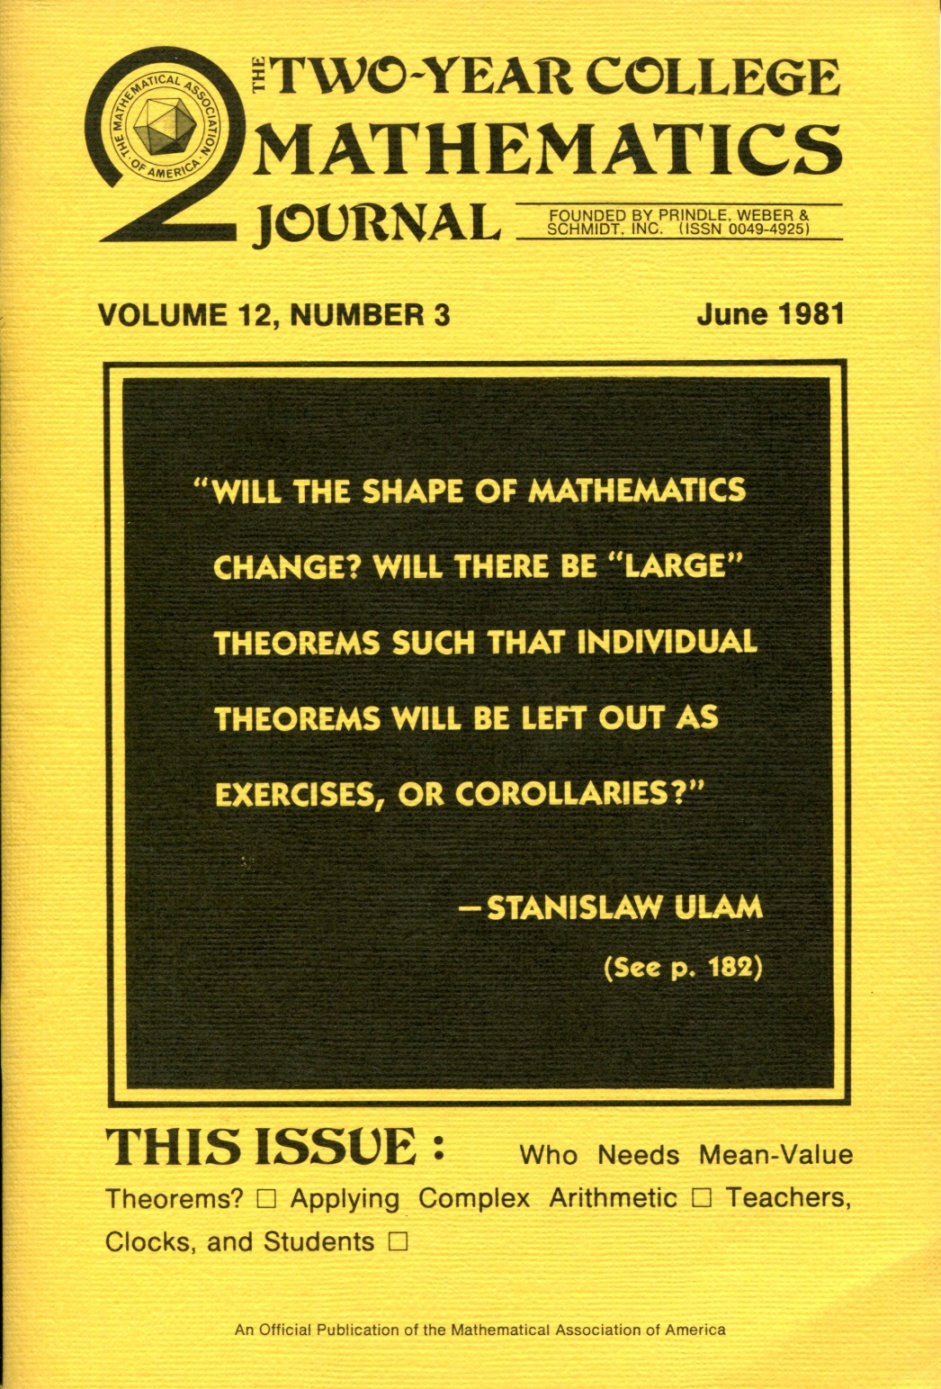
Notes:
Ulam’s interview was the cover story of the June 1981 TYCMJ.

Slide 32
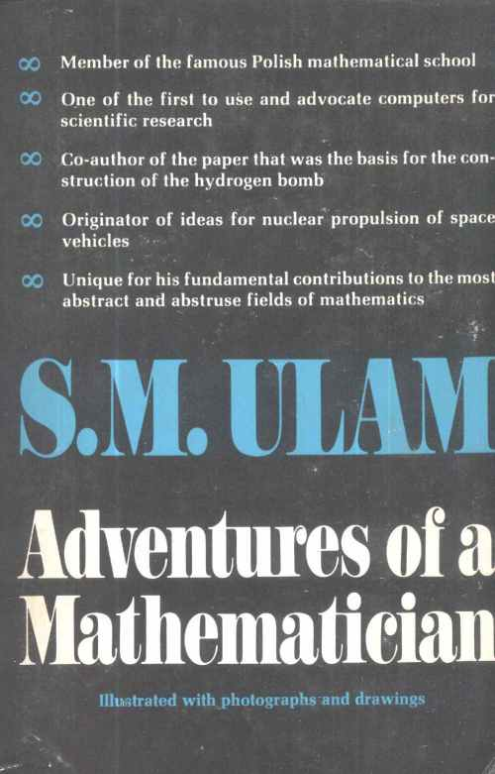
Adventures of a Mathematician
Notes:
I got Stan to autograph my copy of his autobiography Adventures of a Mathematician. The inscription, dated March 7, 1979, says, “To Tony Barcellos in admiration of his science `reportings’ and best wishes. Stan Ulam”. Not sure why “reportings” got quotes!

Slide 33
Notes:
Ulam agreed that his biggest brush with fame came with Herblock’s portrayal of his as a counterweight to his colleague Edward Teller. They had worked together closely on “the Super” project at Los Alamos that resulted in the H-bomb. While Teller was an avid self-promoter who never tired of wearing “Father of the H-bomb” as a title, Ulam was more modest. However, when Teller argued against the need for a test-ban treat, Ulam stepped forward to endorse the Kennedy Administration’s efforts (which were successful under President Johnson).

Slide 34
Benoit Mandelbrot
Notes:
I interviewed Benoit Mandelbrot by phone from Sen. Rodda’s office in the Commission on State Finance suite in State Office Building 1. All I needed were enough remarks to provide a sidebar for an article Don Albers had commissioned for the TYCMJ, “The Fractal Geometry of Mandelbrot.” Mandelbrot gave me much, much more. Don asked me to use the additional material as an interview of Mandelbrot, which later appeared in Mathematical People.

Slide 35
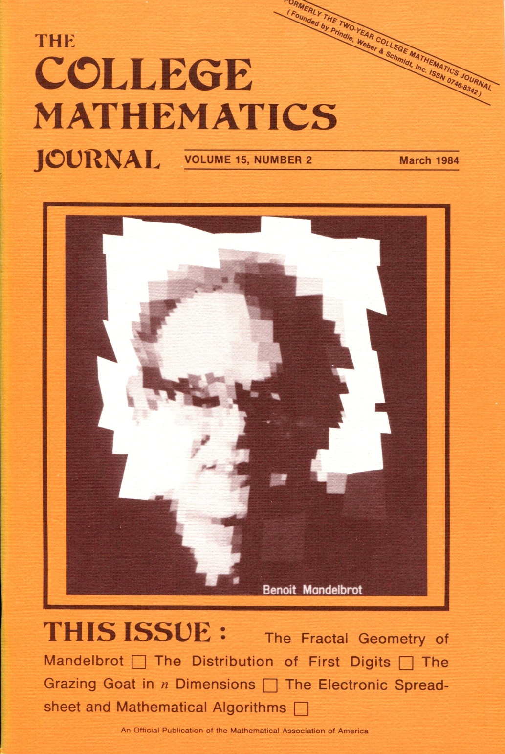
Notes:
The pseudo-fractal portrait of Mandelbrot was my third cover story for the Journal (and eventually garnered both the George Pólya Award and the Merten M. Hasse Prize for expository writing).

Slide 36
The graph [corrected!]
Notes:
The iterative generation of a fractal pattern. (It had a typo in the original publication!)

Slide 37
The Interview
The most important autobiographical piece was “Benoit Mandelbrot, Interview by Anthony Barcellos,” in Mathematical People: Profiles and Interviews.
Notes:
The Mandelbrot interview has been recognized as an important autobiographical document. Mandelbrot was exceedingly generous in the time he devoted to giving me feedback and details.

Slide 38
Mandelbrot Interview
Before: You are tirelessly imaginative and are the true father of fractals.
Notes:
Occasionally, though, Benoit got a little carried away. He sent me pages containing questions he put in my mouth. Some of them were a little too much. Like this one.

Slide 39
Mandelbrot Interview
Before: You are tirelessly imaginative and are the true father of fractals.
After: You are often referred to as “the father of fractals,” and you have been called “tirelessly imaginative.”
Notes:
But that was okay. If necessary, I rewrote them before shipping them off to Don. I was careful, though, to preserve the key words he applied to himself. After all, it’s not as though they were untrue.

Slide 40
John Horton Conway
Notes:
At one point, I was preparing to write a small history of John Horton Conway’s famous (infamous?) Game of Life, which had eaten millions (billions?) of hours of computer time after Martin Gardner published its details in Scientific American. I was privileged to meet Conway and interview him, but—sadly—my publisher faded away and the effort came to naught. Here, however, is a small item from my notes.

Slide 41
St Paul’s Square, Birmingham
Notes:
Conway told me that among the many experiments with the rules of Life were some that toyed with the use of sexes. Eventually, however, Conway and his collaborators noted that the sexes had become irrelevant in the more interesting recursion rules and could be dropped. Up to that point, the Life cells had been labeled either A or B: A for “Actress” and B for “Bishop.” Conceivably, therefore, Conway’s Game of Life could have ended up known as “Actresses & Bishops,” but this was not to be.

Slide 42
The End?
Notes:
This amusing postscript actually belongs at the very beginning of the story. In 1957 my kindergarten teacher wrote the above note to my parents: “Tony does very good number work.”

