Slide 1

Math Performance Success
Diane Mathios
mathiosdiane@deanza.edu
De Anza College
Notes:
Have been teaching with MPS since its inception in 1999. My MPS class are my favorites to teach.
At some point, acknowledge other MPS instructors attending session: Rich, Kathy, Mo, Doli, Mehrdad, Nina, KJ, Barbara

Slide 2
Developmental Math challenges
Low Success
Low Progression Rate
Not Reaching Educational Goals
Notes:
Students have often had multiple failures – low confidence
Low progression in moving from course to course in the sequence

Slide 3
De Anza’s Solution
Math Performance Success (MPS) Program:
  Intensive Student Services
  Cohort Approach
  Common Curriculum
  Common Faculty
Notes:
Eleven years – 1999 was first year under MPS
Pilot program in 1997-98
Counselor attends class during the second hour – provides immediate intervention to students. Deals with attendance, HW, grade issues. These often lead to interventions for personal issues that interfere with learning
As a cohort – Students encourage each other – become part of the group – want to succeed with the group. Bond with instructor – instructor bonds with them – instructor is invested in having the students succeed.

Slide 4
Program Structure
Team Approach
Student Cohorts
Double Class Time
Counseling
Peer Tutors
Active Learning
High Risk Students

Slide 5
Program Structure
High Risk Students
  Lack of Success in Math
  Low Math Self-confidence
  Many from Special Programs
    Learning and Physical Disabilities
    Under-represented Groups
    Low Income
  Referrals from Instructors & Counselors

Slide 6
Program Structure
Counseling
  Application Processing
  Program Orientation
  Student Contract
    Explicit Expectations
    Noncompliance ➔ Termination
  Frequent Counseling Intervention
  Academic & Personal
  Student Success Workshops
Notes:
Students must apply to program
Orientation occurs on first day
Copy of student contract is in packet
Presently we have 1 full time counselor(covers 3 classes) and 3 academic advisors (total 30 hours in/out of class) – process apps – some cover classes as counselor

Slide 7
Program Structure
Cohorts
  Year-long sequences
    Elem. Alg. → Interm. Alg. → Statistics
    Pre-Alg. → Elem. Alg. → Interm. Alg.
  Start Any Quarter
  Sense of Community
  Same Instructor
  Lasting Relationships
    Student-Student
    Instructor-Student

Slide 8
Program Structure
Student Tutors
  In-class: Daily, with Consistent Tutors
  Drop-in Available: ≈ 50 hours/week
  Individual Attention
  Encourages Study Groups
  Mandatory Tutoring when Grades < 70% at Any Point in Term
  Many Tutors are Former MPS Students
Notes:
Required Attendance – reinforce that failing students will often
drop if they aren’t mandated to go to tutoring

Slide 9
Program Structure
Active Learning
  In-class Practice
  Group Work
  Small Group Discussion
  Collaborative Learning
Notes:
DOLI

Slide 10
Program Structure
Double Time
  10 Hours per Week (5 units)
  Double Load for Instructor
  Allows Flexibility to Meet Student Needs
Notes:
DOLI

Slide 11
Program Structure
Team Approach
  Instructors, Counselors, Administrators, Advisors, Tutors
  Weekly Team Meetings
  Deepens Working Relationships
Notes:
DOLI
Weekly team meetings:
Plan activities, e.g. ceremony, speakers
Support group

Slide 12
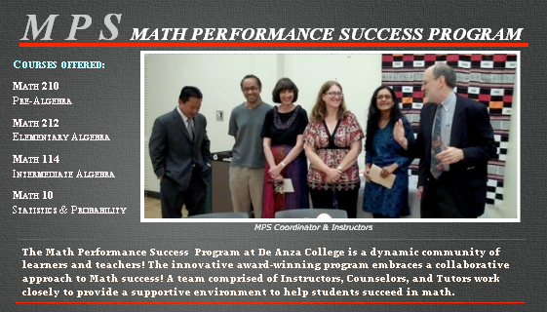
De Anza MPS Website
12
Notes:
12
Website is still under construction – application is up, but students cannot apply online to program – working on getting the application submission secure so that students can apply online

Slide 13
Student testimonial
“School-wise MPS is the best thing that has happened in my life. Math is a difficult subject, but thanks to the professor, tutors, and counselors, I am completing my math requirements for my major. The teachers and tutors really make math a lot less complicated and make it somewhat fun. I strongly recommend the program to students that don’t have a strong background in math.”
- Saul Gembe

Slide 14
Student testimonial
“When I first started out, I had no idea how intense the class was going to be. The labs, Homework, projects, exams, quizzes, etc…were overwhelming to me, but, as the weeks went by I understood why all this was necessary. I began to understand why and how things in the program worked. I was no longer overwhelmed and felt confident again that I am smart enough for math.”
- Emily Ikuta

Slide 15
Student testimonial
“The MPS Program has definitely helped me understand Math. In the past, it was very difficult to grasp different concepts. Now, I find myself at times helping other people with it.”
- Godfrey Ramos

Slide 16
Cumulative Data: 2001 – 2010
 | Non-MPS |  | MPS
 | n | Pass | n | Pass | Diff
Pre-Algebra | 1980 | 55% | 126 | 73% | 18%
F: 06-09
Elem. Algebra | 9945 | 56% | 823 | 77% | 21%
F: 01-09, W: 07-10
Inter. Algebra | 9419 | 58% | 850 | 82% | 24%
W: 02-10, S: 07-09
Statistics | 7899 | 62% | 626 | 90% | 28%
S: 02-09, F: 08
16
Notes:
Prealgebra strand was added fall 2006 -
16

Slide 17
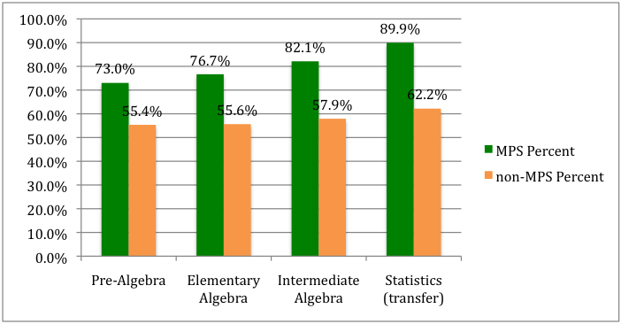
Cumulative “Pass”: 2001 – 2010

Slide 18
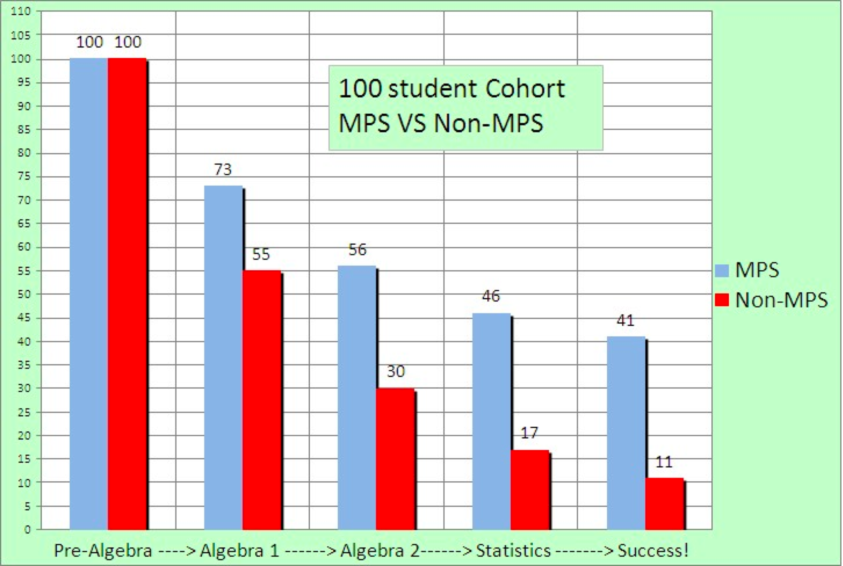

Slide 19
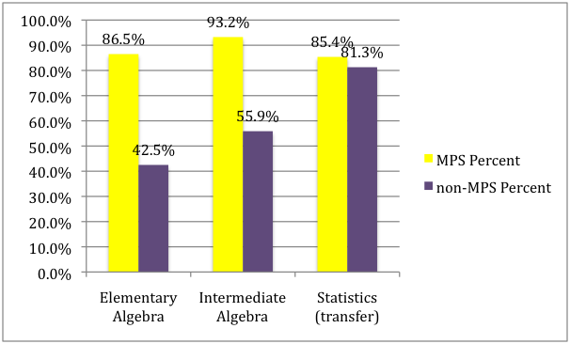
Data for Single Instructor
Notes:
One teacher with MPS and non-MPS classes comparison
Several years of data over time teaching in MPS
Addresses question “Students do better because instructors better – or instructors are easier”

Slide 20
Success Rates by Ethnicity
2009-10 and 2010-11
Pre-Algebra
Notes:
Under- represented: Af Am, Hispanic, Native Am, Filipino, Multiple race

Slide 21
Success Rates by Ethnicity
2009-10 and 2010-11
Elementary Algebra

Slide 22
Success Rates by Ethnicity
2009-10 and 2010-11
Intermediate Algebra

Slide 23
Percent Success by Ethnicity
2009-10 and 2010-11
Statistics

Slide 24
Challenges
Instructors
Counseling
Coordination
Facilities
Politics
Growth

Slide 25
Challenges
Instructors
  Must Commit to Cohort for Year
  Emotionally Exhausting
  Requires More Preparation
  Extra Activities
  Recruitment

Slide 26
Challenges
Coordination
  Student Recruitment and Registration
  Availability of Staff for Weekly Meetings
  Extensive Commitment for Adjunct Faculty
  Tutor Recruitment & Training
  Collaboration Among Counselors, Tutors & Faculty
Notes:
Hard to find a time when all faculty available
Often, best tutors are former MPS students because they know how the program works

Slide 27
Challenges
Counselors
  Recruitment & Reluctance
  Dilution of Services
  High Demand, Low Supply
Notes:
Not the typical role for Counselors
Don’t always recognize the connection between performance in class and personal issues of students
Budget constraints make it hard to release counselors to program
Fall 2010 – 750+ applications for 220 spots

Slide 28
Challenges
Facilities
  Rooms for Double Time
  Shortage of Classrooms on Campus
  More Accommodations for Special Needs Students
Notes:
Each additional MPS section means another regular section NOT offered

Slide 29
Challenges
Politics
  Conflicting Philosophies
  Resource Distribution
Notes:
Conflicting Philosophies regarding role of counselors and instructors

Slide 30
Challenges
Growth
  Exacerbates Existing Challenges
  Recruitment and Training
  Increased Complexity in Coordination
  “Cost”
  Requires Cultural Change across Institution
Notes:
Recruitment and Training: instructors, counselors and tutors; need careful recruitment, new members need to understand and embrace the philosophy and culture of MPS
Coordination: communication, etc.

Slide 31
Benefits
Successful Students
Enriched College Experience
Moral & Ethical Reasons
Program Components Applicable to Other Developmental Disciplines

Slide 32
Recognition and Support
2002 CCC Senate Exemplary Program
2009 Cited as Exemplary Program by CA’s Basic Skills Initiative
2009 Recipient of Hewlett Foundation Award
Partially Supported by Title III Grant
Financially Supported by De Anza Student Body
Notes:
CCC Senate Exemplary Program – were nominated again this year. Did not receive it.
MPS is also part of BSI Trainings
Current DA Student Body Funding is $42,000. One year they increased what we asked for

Slide 33
Implementing at Your Institution
Educate Everyone
- Instructors
- Student Body
- Grant Funders
- Counselors
- Administration
Maintain, Analyze and Share Data
Start Small
Notes:
Use ‘assessment’ when discussing data

Slide 34
Resources
Math Performance Success (MPS):
http://nebula.deanza.edu/PSME_Division/MPS.html
CA Basic Skills Initiative:
http://www.cccbsi.org/literature-review
Contact Us:
MathiosDiane@deanza.edu
HernandoHerminio@deanza.edu
RosenbergJerry@deanza.edu
Notes:
MPS Website still being developed

